Slide 1
A Trial to Evaluate the Efficacy and Safety of PQ912 in Patients with Early AD –
Phase 2A
(VIVA-MIND)
&
The National Centralized Repository for Alzheimer’s Disease and Related Dementias (NCRAD)
Biofluids Collection Training Slides

Slide 2
Training Overview
GUIDs
Specimen Collection Schedule
Kit Request Module
CSF Screening Reporter
Specimen Labels
Handling/Processing Study Specimens
Sample Shipping
NCRAD Website
Questions

Slide 3

Contact Information
Questions?
Please contact NCRAD Coordinator at:
  VIVAMIND Coordinator: Diont’e Keys
  Phone: 317-274-7890
  CRC email: dlkeys@iupui.edu
  Back-up email: alzstudy@iu.edu
  Website: www.ncrad.org

Slide 4
Globally Unique Identifier (GUID)
The GUID is a subject ID that allows researchers to share data specific to a study participant, without exposing personally identifiable information
A GUID is made up of random alpha-numeric characters and does not include any PHI in the identifier

Slide 5
Globally Unique Identifier (GUID)
Create an account: https://bricsguid.nia.nih.gov/portal/jsp/login.jsp
  Note that it may take a few days for your account to be approved
Once you have an account, go to the GUID Tool – Create GUID
To open the ‘Launch GUID Tool’ you will need to have Java installed on your device
When the GUID Tool is open, you will need all of the following information
  Complete legal given (first)name of participant at birth
  The participant’s middle name, if applicable
  Complete legal family (last) name of subject at birth
  Day of birth
  Month of birth
  Year of birth
  Name of city/municipality in which subject was born
  Country of birth

Slide 6
Biospecimen Collection Schedule
 | PRE-DOSE |  | POST-DOSE
 | Serum (Red Top) | Plasma/Buffy Coat (EDTA, Lavender Top) | Serum (Red Top) | Plasma/Buffy Coat (EDTA, Lavender Top) | Cerebrospinal Fluid (CSF)
Screening | X |  |  |  | X
Baseline | X | X
Week 4 | X | X | X | X
Week 8 | X | X | X | X
Week 16 (Cohorts A & B) | X | X | X | X
Week 24 | X | X | X | X | X (2A participants only)*
Week 48 | X | X | X | X
Week 72 | X | X | X | X | X*
Early Termination | X | X | X | X | X**

Slide 7
Biospecimen Collection for Screening Visit
Sample Type | Tube Type | Tubes Supplied in Kit | Aliquot Volume | Tubes to NCRAD | Ship
Whole blood for serum banking | Serum (Red-Top) Tube (10 mL) | 1 | N/A | N/A | N/A
 | Serum: 2.0 ml cryovials with red cap (residual volume placed in 2.0 ml cryovial with blue cap) | 11 | SERUM: 0.5 ml serum aliquots per 2.0 ml cryovial | Up to 11 | Frozen
CSF Collection | Sterile Containers (15 ml CSF) | (1) 2.0 ml Sarstedt tube | CSF: 2.0 ml CSF per 2.0ml Sarstedt tube | 1 | Frozen
 |  | 26 cyrovial tubes (25 orange cap, 1 blue cap) | 0.5 ml CSF aliquots per 2.0 ml orange cryovial; residual volume placed in 2.0 ml cryovial with blue cap | Up to 26
 |  | 1 yellow cap cryovial tube | 1-2 ml for local lab placed in 2.0 ml cryovial with yellow cap. | 0 – do not return to NCRAD | N/A

Slide 8
Biospecimen Collection for Baseline Pre-dose, Weeks 4/8/16/24/48/72/ET
Pre-dose and Post-dose Visits
Sample Type | Tube Type | Tubes Supplied in Kit | Aliquot Volume | Tubes to NCRAD | Ship
Whole blood for serum banking | Serum (Red-Top) Tube (10 mL) | 1 | N/A | N/A | N/A
 | Serum: 2.0 ml cryovials with red cap (residual volume placed in 2.0 ml cryovial with blue cap) | 11 | SERUM: 0.5 ml serum aliquots per 2.0 ml cryovial | Up to 11 | Frozen
Whole blood for isolation of plasma and buffy coat | EDTA (Lavender-Top) Blood Collection Tube (10 ml) | 1 | N/A | N/A | N/A
 | Plasma: 2.0 ml cryovials with lavender cap (residual volume placed in 2.0 ml cryovial with blue cap) | 11 | PLASMA: 0.5 ml plasma aliquots per 2.0 ml cryovial | Up to 11 | Frozen
 | Buffy Coat: 2.0 ml cryovial | 1 | BUFFY COAT: 0.75 ml buffy coat aliquot | 1 | Frozen

Slide 9
Biospecimen Collection for Week 24 and 72 Pre-dose and Post-dose Visit
Sample Type | Collection Tube | Tubes Supplied in Kit | Processing/ Aliquoting | Tubes to NCRAD | Ship
Whole blood for serum banking | Serum (Red-Top) Tube (10 mL) | 1 | N/A | N/A | N/A
 | Serum: 2.0 ml cryovials with red cap (residual volume placed in 2.0 ml cryovial with blue cap) | 11 | SERUM: 0.5 ml serum aliquots per 2.0 ml cryovial | Up to 11 | Frozen
Whole blood for isolation of plasma and buffy coat | EDTA (Lavender-Top) Blood Collection Tube (10 ml) | 1 | N/A | N/A | N/A
 | Plasma: 2.0 ml cryovials with lavender cap (residual volume placed in 2.0 ml cryovial with blue cap) | 11 | PLASMA: 0.5 ml plasma aliquots per 2.0 ml cryovial | Up to 11 | Frozen
 | Buffy Coat: 2.0 ml cryovial | 1 | BUFFY COAT: 0.75 ml buffy coat aliquot | 1 | Frozen
CSF Collection (For CSF, we are NOT collecting both pre-dose and post-dose. Only one collection per visit.) | Sterile Containers (15 ml CSF) | (1) 2.0ml Sarstedt tube | CSF: 2.0 ml CSF per 2.0ml Sarstedt tube | 1 | Frozen
 |  | 26 cyrovial tubes (25 orange cap, 1 blue cap) | 0.5 ml CSF aliquots per 2.0 ml orange cryovial; residual volume placed in 2.0 ml cryovial with blue cap | Up to 26 | Frozen
 |  | 1 yellow cap cryovial tube | 1-2 ml for local lab placed in 2.0 ml cryovial with yellow cap. | 0 – do not return to NCRAD | N/A

Slide 10
Biospecimen Collection for Early Termination Pre-Dose and Post-Dose Visit
Sample Type | Collection Tube | Tubes Supplied in Kit | Processing/ Aliquoting | Tubes to NCRAD | Ship
Whole blood for serum banking | Serum (Red-Top) Tube (10 mL) | 1 | N/A | N/A | N/A
 | Serum: 2.0 ml cryovials with red cap (residual volume placed in 2.0 ml cryovial with blue cap) | 11 | SERUM: 0.5 ml serum aliquots per 2.0 ml cryovial | Up to 11 | Frozen
Whole blood for isolation of plasma and buffy coat | EDTA (Lavender-Top) Blood Collection Tube (10 ml) | 1 | N/A | N/A | N/A
 | Plasma: 2.0 ml cryovials with lavender cap (residual volume placed in 2.0 ml cryovial with blue cap) | 11 | PLASMA: 0.5 ml plasma aliquots per 2.0 ml cryovial | Up to 11 | Frozen
 | Buffy Coat: 2.0 ml cryovial | 1 | BUFFY COAT: 0.75 ml buffy coat aliquot | 1 | Frozen
CSF Collection (For CSF, we are NOT collecting both pre-dose and post-dose. Only one collection per visit.) | Sterile Containers (15 ml CSF) | (1) 2.0ml Sarstedt tube | CSF: 2.0 ml CSF per 2.0ml Sarstedt tube | 1 | Frozen
 |  | 26 cyrovial tubes (25 orange cap, 1 blue cap) | 0.5 ml CSF aliquots per 2.0 ml orange cryovial; residual volume placed in 2.0 ml cryovial with blue cap | Up to 26 | Frozen
 |  | 1 yellow cap cryovial tube | 1-2 ml for local lab placed in 2.0 ml cryovial with yellow cap. | 0 – do not send to NCRAD | N/A

Slide 11

Kit Request Module
http://kits.iu.edu/vivamind

Slide 12
Kit Request Module
An initial stock of kits will be delivered prior to the designated site-specific start date.
Kits and individual supplies available to order:
  Blood Collection Kits:
    Baseline Pre-Dose, Weeks 4/8/16/24/72/ET Pre-dose, Post-dose
  CSF Kits:
    Screening, Week 24, ET
  LP 22 Gauge Kit
  LP 24 Gauge Kit
  Blood Supplemental Kit
  CSF Supplemental Kit
  Frozen Shipping Kit – Batch Shipments
  Frozen Shipping Kit – Individual for Screening CSF
  Individual Supplies

Slide 13
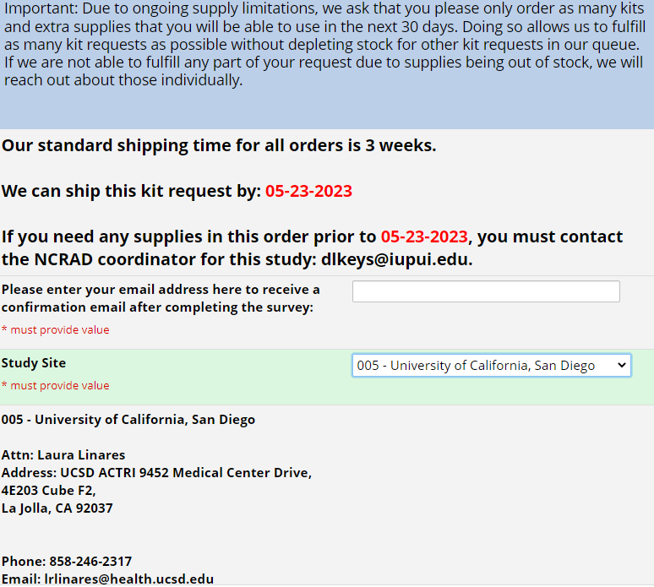
Kit Request Module
Choose your site from the drop-down list.
The coordinator name and contact information will populate.
Verify that this information is correct.

Slide 14
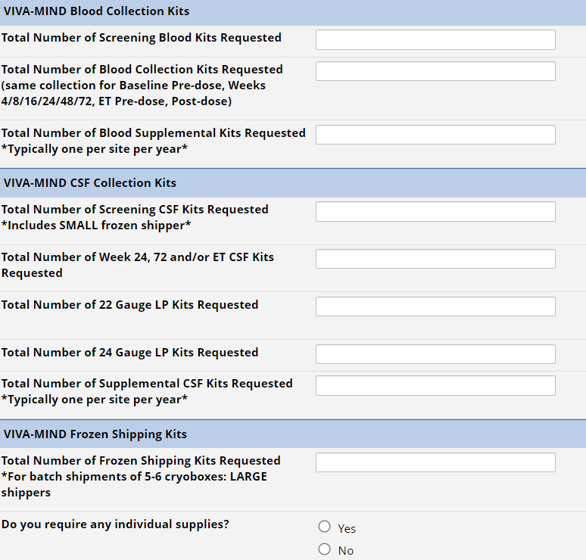
Kit Request Module: Kit Selection
Indicate the quantity needed of each kit.
Once selected, kit components of the chosen kit will appear at the bottom of the screen (Pictured)
**Note: You can order more than one type of kit in a single kit request**

Slide 15
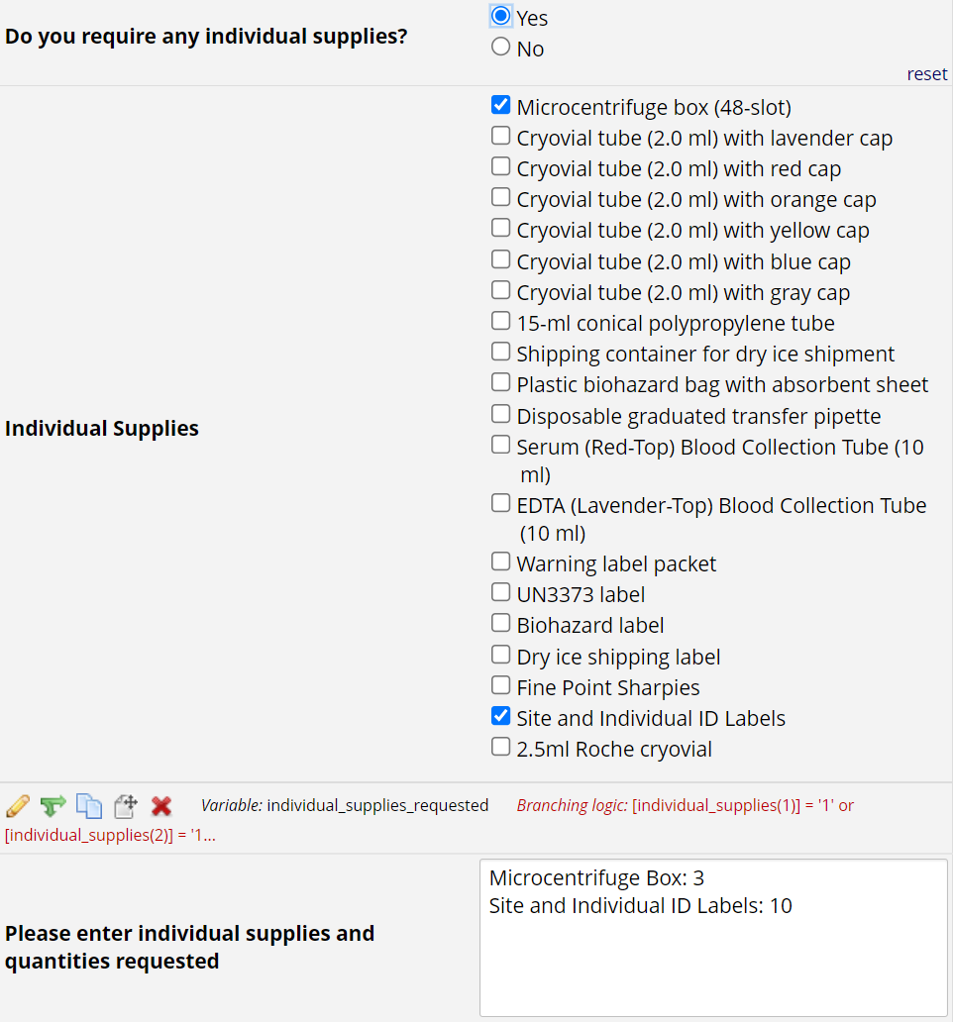
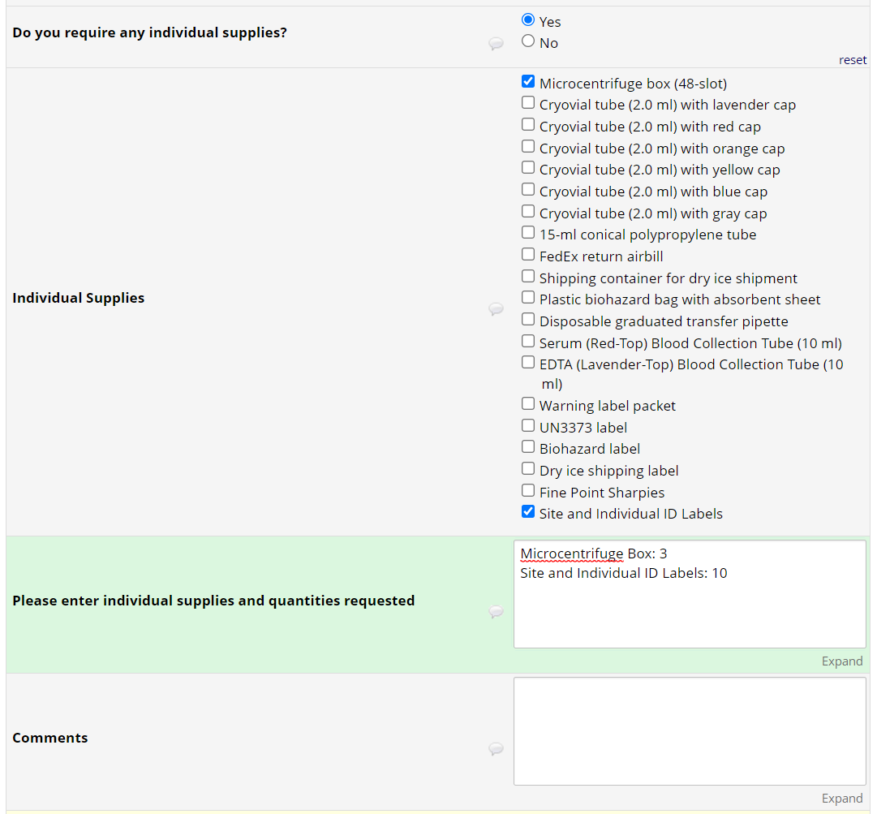
Kit Request Module: Kit Selection
For individual supplies, select the ones needed and specify quantities below.
Click “Submit” to turn in your request.
The IU staff will notify you that your request has been received and address any issues.

Slide 16
Kit Request Module
Each site is responsible for ordering kits and maintaining supplies on site for their scheduled participants.
To order kits, sites will use the Indiana University online kit ordering module: http://www.kits.iu.edu/vivamind
Allow around 2-3 weeks for your order to be processed and delivered.

Slide 17
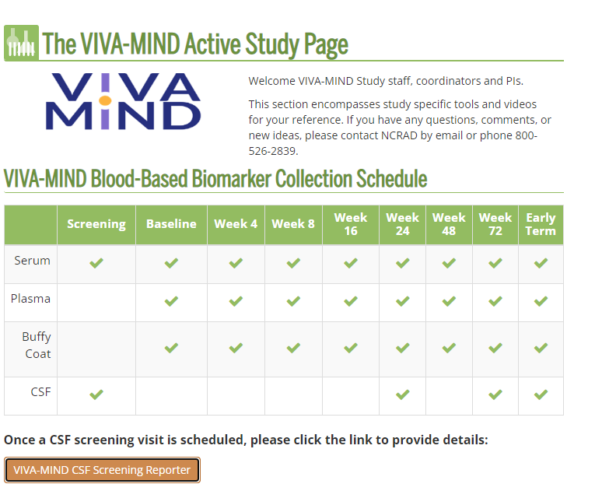
CSF Screening Reporter

Slide 18
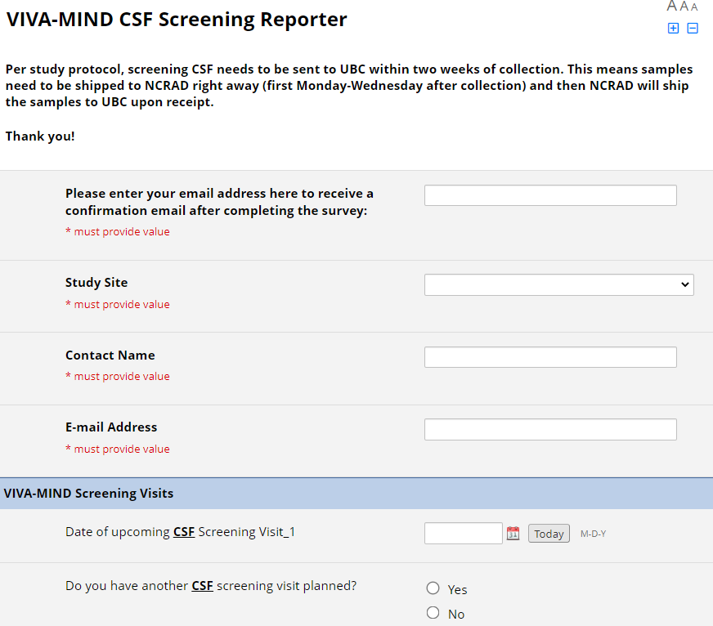
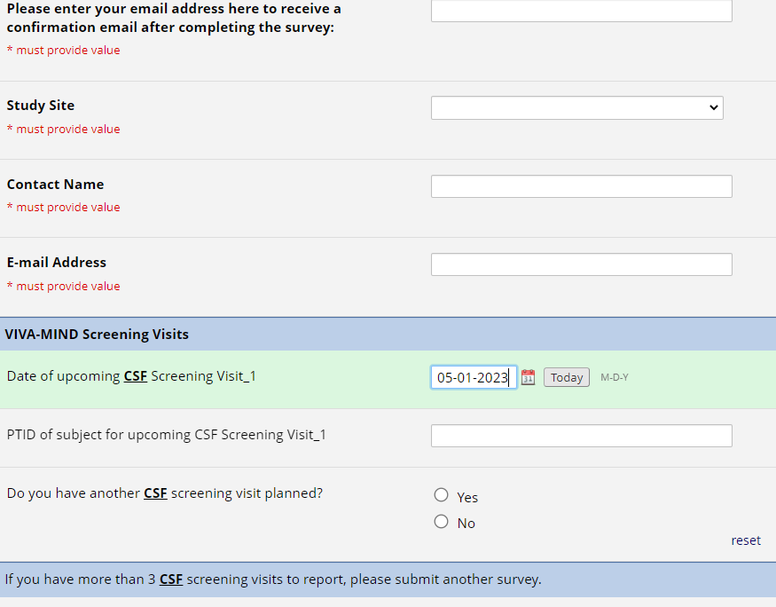
CSF Screening Reporter
Provide your email to receive a confirmation for your submission.
The site number and site abbreviation will populate.
Enter contact name and email address to avoid any issues with receiving a confirmation email
Enter in the date of the CSF screening visit.
Enter in the PID of the participant.
**Note: You can enter up to 3 dates for a CSF Screening Visit and will be able can use the comments section to enter any additional dates**

Slide 19
Specimen Labels

Slide 20
Specimen Labels
Label type summary:
  Kit Number Labels
  Site and ADCS ID Labels
  Aliquot Tube Labels
    Differ by specimen type
  Sarstedt CSF Tube Label
All labels are provided in the kits

Slide 21
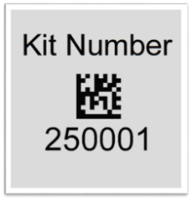
Specimen Labels: Kit Number Labels
Used to track patient samples and provide quality assurance
Will be placed on:
  All blood collection tubes
  Biological Sample and Shipment Notification Form
  CSF Sample and Shipment Notification Form
    CSF samples will have a different kit number than blood samples
  Outside of microcentrifuge box(es) that contain aliquot tubes during storage and shipment

Slide 22
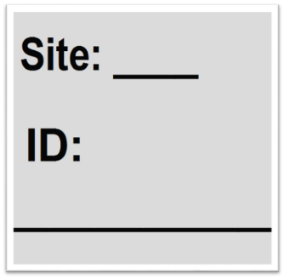
Specimen Labels: Site and ADCS ID Labels
Subjects will be identified by their site ID and ADCS ID
Sites will be responsible for handwriting the IDs on the provided labels
  Fill in labels prior to adhering to tubes
  Must use fine-point marker
  Each site will receive a 2-pack of markers in initial kit supply
Labels will be placed on all collection tubes:
  EDTA Lavender Top Tube (10 ml)
  Serum Red Top Tube (10 ml)
ADCS ID:

Slide 23
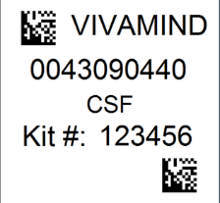
Specimen Labels: Sarstedt CSF Tube Label
Used to track respective participants 2ml Sarstedt CSF Tube
Sites will be responsible for applying this label to the 2ml Sarstedt Tube.
  This label will differ from the CSF Aliquot Tube labels that will be placed on the CSF orange cap cryovials.

Slide 24
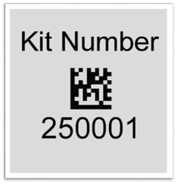
Specimen Labels: Aliquot Tube Labels
VIVA-MIND
Plasma
Kit: 250001
Study Name
Sample Type (Plasma, Buffy Coat, Serum, or CSF)
Kit # (Assigned by NCRAD and unique to the subject and visit)

Slide 25
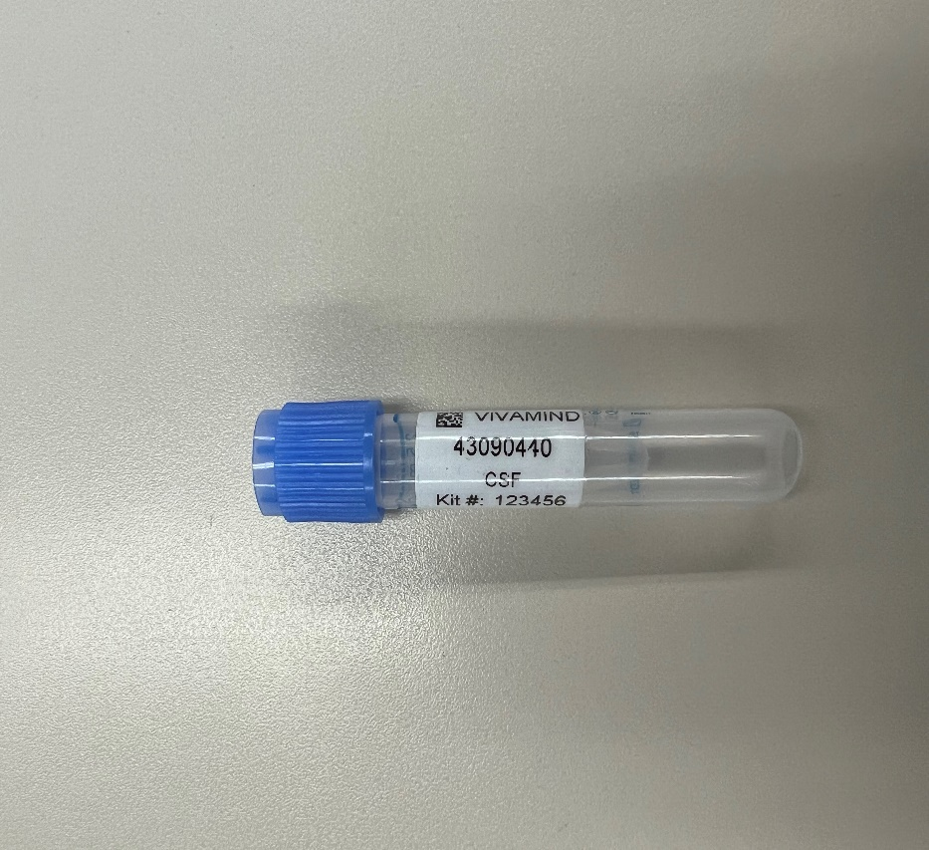
Specimen Labels: 2ML Sarstedt CSF Tube Label
Study Name
Specimen Barcode
Sample Type (Plasma, Buffy Coat, Serum, or CSF)
Kit # (Assigned by NCRAD and unique to the subject and visit)

Slide 26
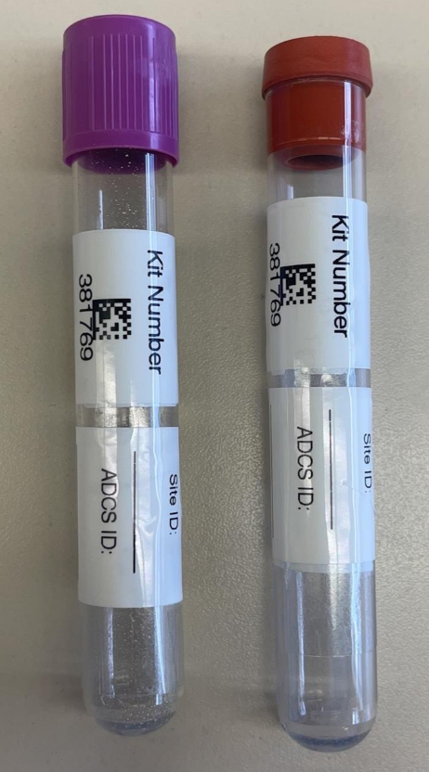
Specimen Labels: Blood Collection Tubes
All collection tubes will have two labels:
  Kit Number Label
  Site and ADCS ID Label
Kit Number Label
Label 1:
Label 2:
Site and ADCS ID Label
ADCS ID:

Slide 27
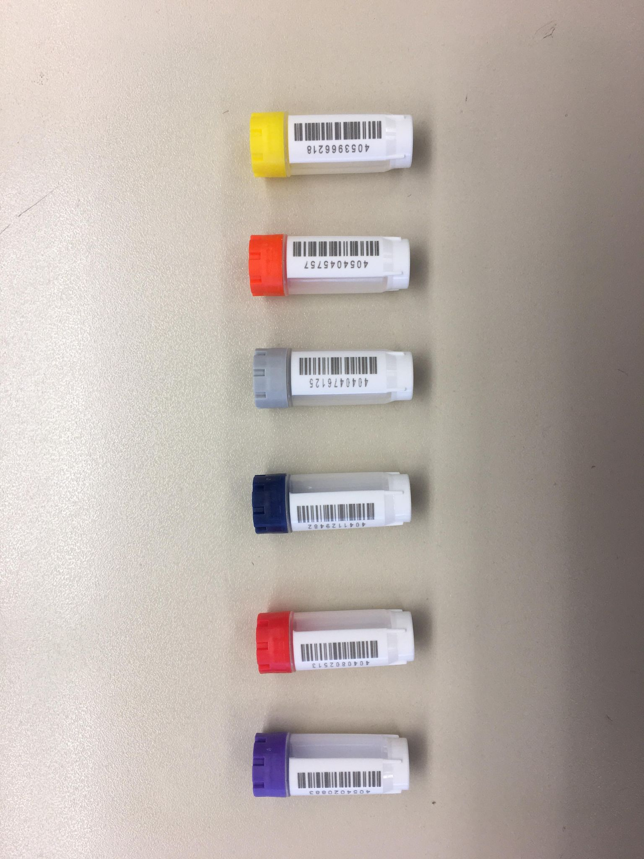
Specimen Labels: Aliquot Tube Labels (Plasma, Buffy Coat, Serum, and CSF)
VIVA-MIND
Plasma
Kit: 250002

Slide 28
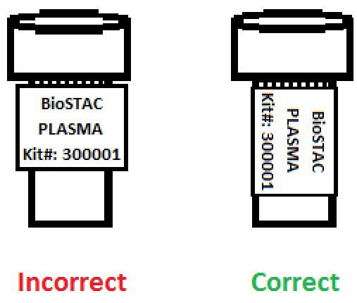
Specimen Labels: Labeling Biologic Samples
Label all collection and aliquot tubes before cooling, collecting, processing or freezing samples.
Label only 1 subject’s tubes at a time to avoid mix-ups.
Wrap the label around the tube horizontally. Label position is important for all tube types.
Make sure the label is completely adhered by rolling between your fingers.
VIVA-MIND
Plasma
Kit: 250001
VIVA-MIND
Plasma
Kit: 250001

Slide 29
Handling/Processing Study Specimens

Slide 30
Site Required Equipment
Blood Collection/Safety Equipment:
Personal Protective Equipment (PPE)
  Lab Coat, Safety Glasses
Tourniquet
Alcohol Prep Pad
Gauze Pad
Butterfly Needles
Bandage
Sharps Bin and Lid
Dry Ice
Processing/Storage Equipment:
Centrifuge capable of ≥2000 rcf with refrigeration to 4⁰C
-80⁰C Freezer
Wet Ice Bucket

Slide 31


Blood Collection & Processing: Sample Collection Tube
Tube Type | Number of Tubes Drawn (per visit) | Tube Image
Serum (Red-Top) Tube (10 ml) | 1
EDTA (Lavender-Top) Tube (10 ml) | 1

Slide 32
Blood Collection & Processing: Draw Order
***Important Note***
In order to ensure the highest quality samples are collected, processed, and stored, it is essential to follow the specific collection, processing, and shipment procedures detailed in the following pages. Please read the following instructions first before collecting any specimens. Have all your supplies and equipment out and prepared prior to drawing blood. Please note that the centrifuge may take 30 minutes to cool, so please plan accordingly. Draw blood in the following order:
Plain Red Top Serum Blood Collection Tube (10 ml)
EDTA (Lavender-Top) Blood Collection Tube (10 ml) for Buffy Coat and Plasma

Slide 33
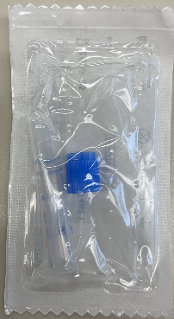
Blood Collection & Processing: Aliquot Cryovials & Cap Colors
Cap Color | Sample Type
Lavender Cap | Plasma
Red Cap | Serum
Blue Cap | Residual
Gray Cap | Buffy Coat
Orange Cap | CSF
Yellow Cap | CSF to Local Lab
Blue Cap – Individually wrapped | Sarstedt tube for Roche for CSF

Slide 34
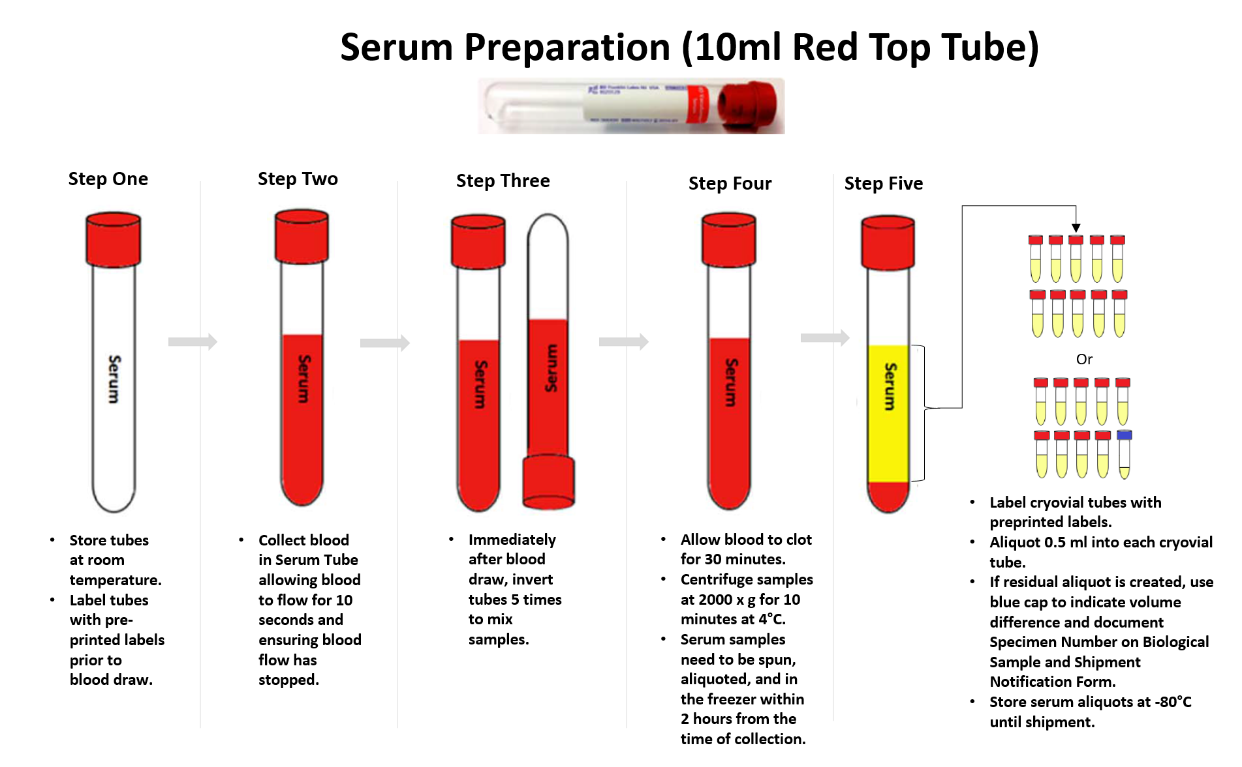

Slide 35
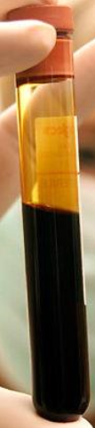
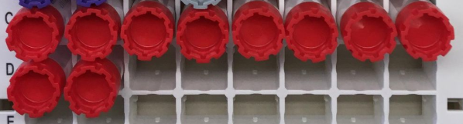
Serum Tube - Serum Collection
Serum
RBC, WBC & Platelet Clot
Up to 10 cryovials possible:
10 x 0.5 ml in red cap cryovials OR
9 x 0.5 ml in red cap & 1 x <0.5 ml blue cap cryovial

Slide 36
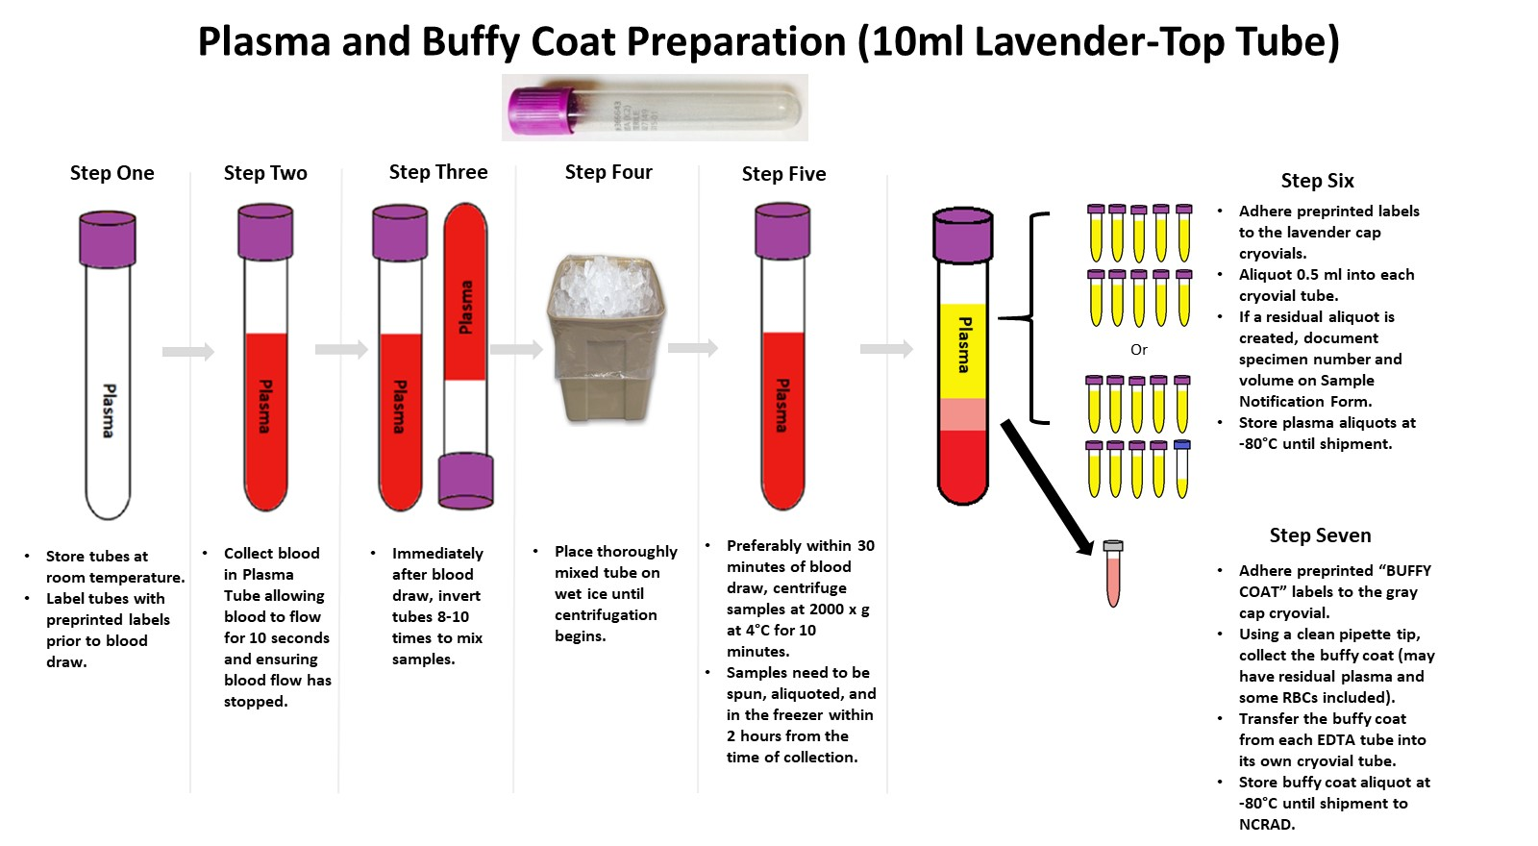

Slide 37

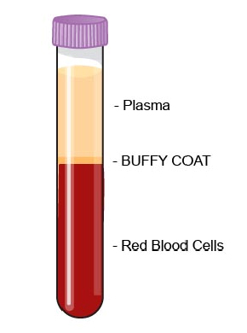
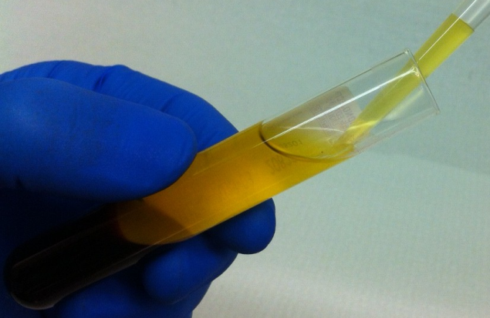
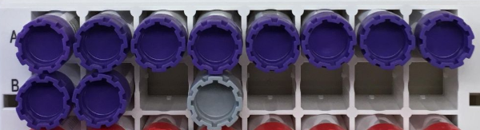
EDTA Tube (10 ml) – Plasma Collection
Up to 10 cryovials possible:
10 x 0.5 ml in lavender cap cryovials
1 x <0.5 ml blue cap cryovial

Slide 38
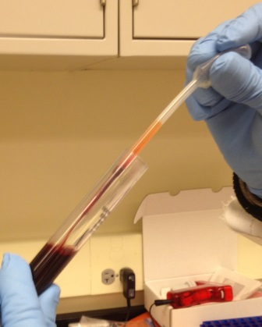
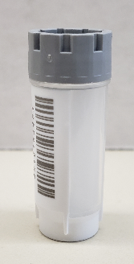
EDTA Tube (10 ml) – Buffy Coat Collection
Buffy Coat Aliquot
(Please use GRAY CAP cryovial)

Slide 39
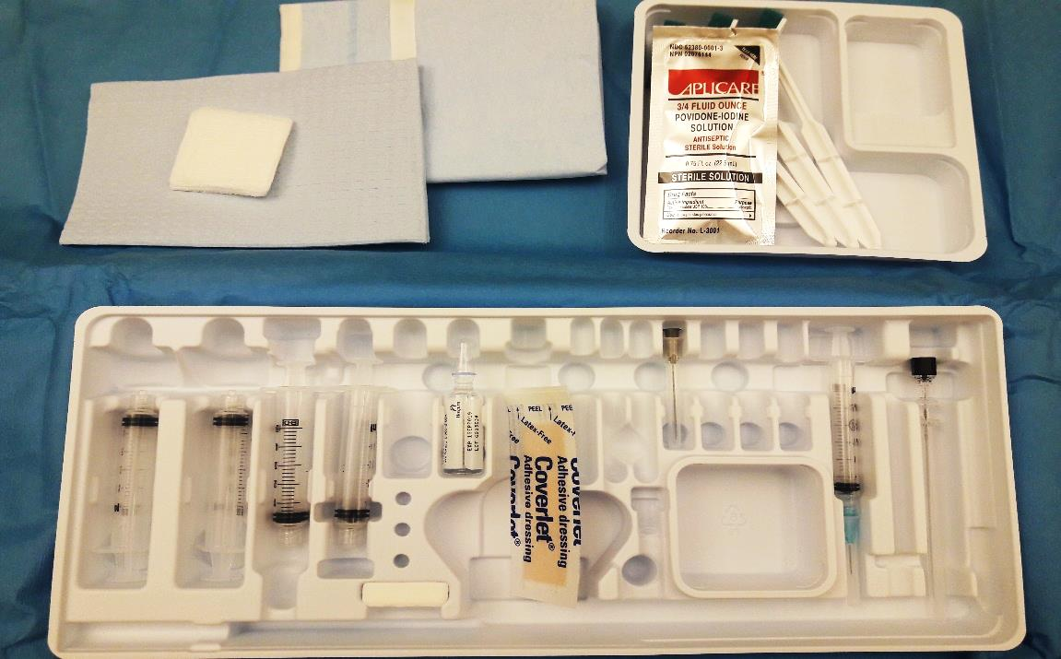
CSF Collection and Processing
***Important Note***
Fasting prior to the lumbar puncture is not required. However, efforts should be made to ensure each LP done on a participant is performed at the same time of day.

Slide 40

CSF Collection & Processing: 2ml Sarstedt CSF Collection Tube
Tube Type | Number of Tubes Drawn (per visit) | Tube Image
2ml Sarstedt CSF (Blue-Top) Tube (2 ml) | 1

Slide 41
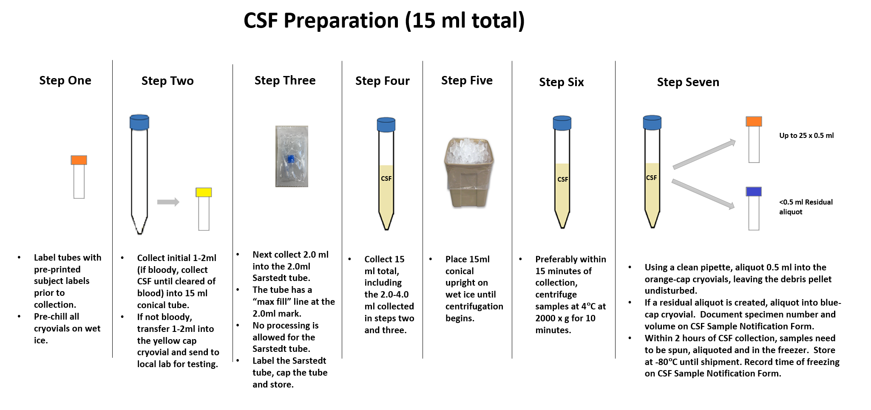

Slide 42
Sample Shipping

Slide 43
Frozen Shipping: Guidelines
Ship Monday-Wednesday Only
Hold packaged samples in a -80°C freezer until pickup.
Screening CSF should be shipped to NCRAD every other week with pelleted dry ice.
Week 24, 72, ET CSF & All Blood Visits: Batch ship samples
  5 Cryoboxes
  Batch shipping should be performed every 3 months or as a full shipment of specimens accumulates, whichever is sooner.

Slide 44
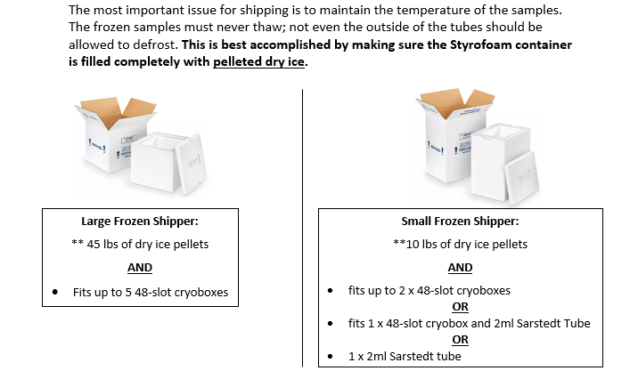

Slide 45
Sample Shipment Summary
Sample Type | Collection Tube | Tubes Supplied in Kit | Processing/ Aliquoting | Tubes to NCRAD | Ship
Whole blood for serum banking | Serum (Red-Top) Tube (10 mL) | 1 | N/A | N/A | N/A
 | Serum: 2.0 ml cryovials with red cap (residual volume placed in 2.0 ml cryovial with blue cap) | 11 | SERUM: 0.5 ml serum aliquots per 2.0 ml cryovial | Up to 11 | Frozen
Whole blood for isolation of plasma and buffy coat | EDTA (Lavender-Top) Blood Collection Tube (10 ml) | 1 | N/A | N/A | N/A
 | Plasma: 2.0 ml cryovials with lavender cap (residual volume placed in 2.0 ml cryovial with blue cap) | 11 | PLASMA: 0.5 ml plasma aliquots per 2.0 ml cryovial | Up to 11 | Frozen
 | Buffy Coat: 2.0 ml cryovial | 1 | BUFFY COAT: 0.75 ml buffy coat aliquot | 1 | Frozen
CSF | Sterile Containers (15 ml CSF) | 27 | CSF: 2.0 ml CSF per 2.0ml Sarstedt tube | 1 | Frozen
 |  |  | CSF: 0.5 ml CSF aliquots per 2.0 ml orange cryovial | Up to 26

Slide 46
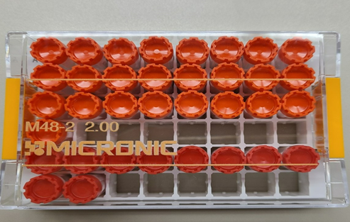
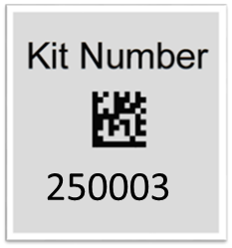


Frozen Shipping: Cryoboxes
Screening Visit Only: Blood and CSF
250002
Place kit number labels (blood and CSF) on each cryobox
Include only one subject per box.

Slide 47
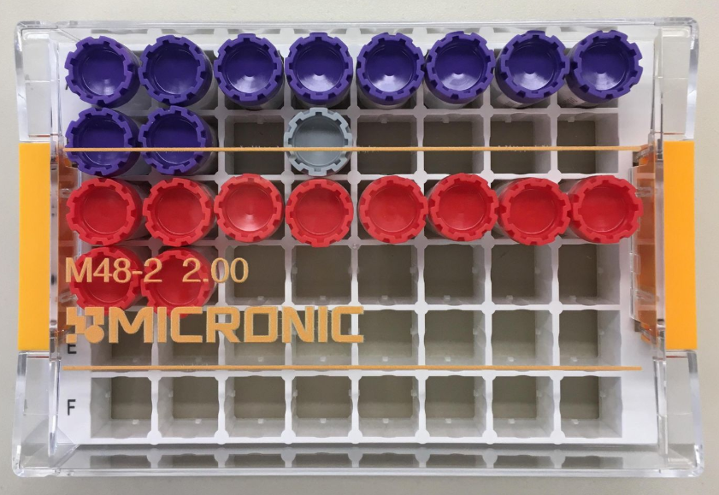
Frozen Shipping: Cryoboxes
Blood Visits: Baseline Pre-Dose, Weeks 4/8/16/24, Early Termination Pre-Dose and Post-Dose
Place kit number labels on each cryobox
Include only one subject per box.

Slide 48
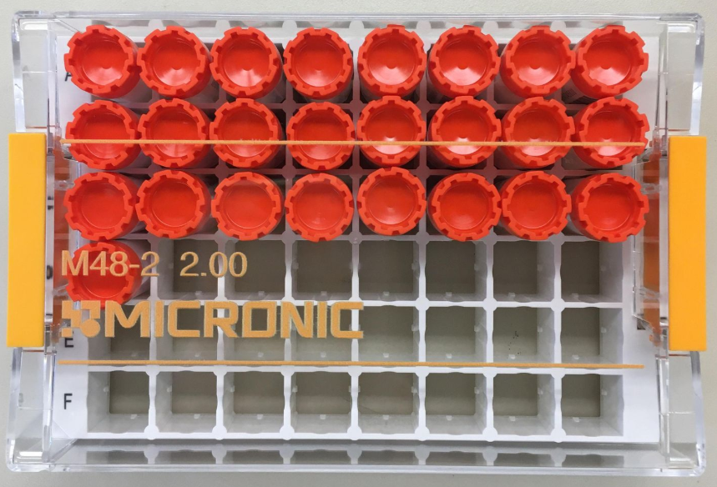
Frozen Shipping: Cryoboxes
CSF Visits: Screening, Week 24, 72, Early Termination
Place kit number labels) on each cryobox
250003
Include only one subject per box.

Slide 49
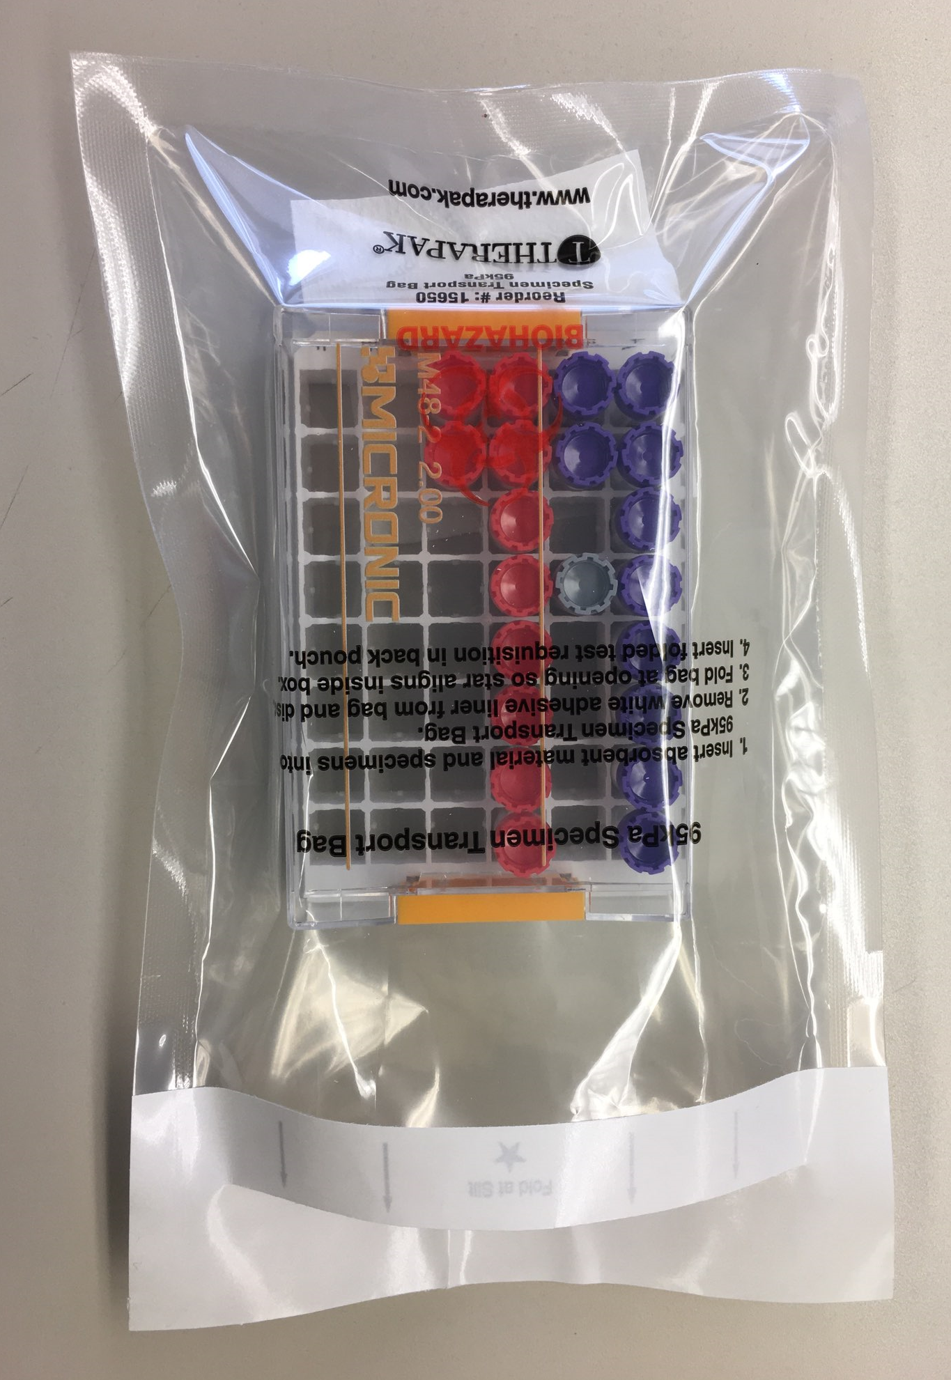
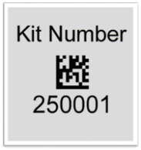
Frozen Shipping: Cryoboxes
Be sure to adhere the necessary Kit Labels on the lid of the cryobox. Only one subject per box.
Place cryobox in one Biohazard Bag.

Slide 50
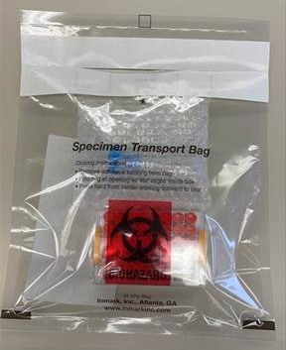
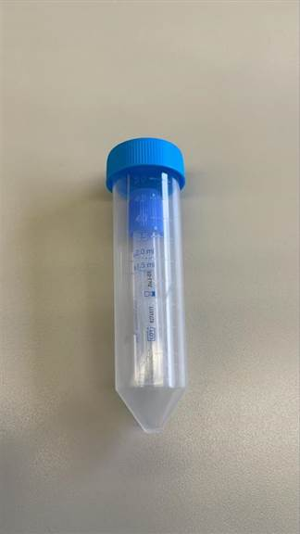
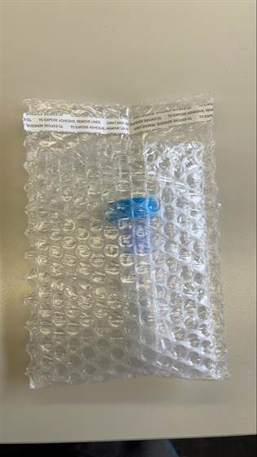
Frozen Shipping: Sarstedt Tube
Place the 2.0ml Sarstedt tube in a 50ml conical. Place the 50ml conical in a bubble wrap tube sleeve and place the bubble wrap in the biohazard bag with the CSF and serum cryovials from the screening visit.
Screening Visit Only-Do NOT batch ship! Ship individually!

Slide 51
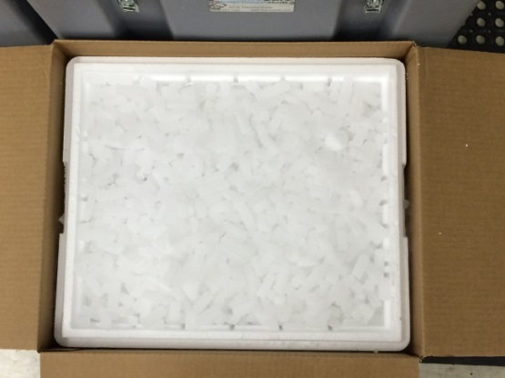
Frozen Shipping: Dry Ice Requirements
Fully cover the cryoboxes with about 2 inches of dry ice in the provided shipper.
Each individual Styrofoam shipper (small) must be completely filled and will contain about 10 lbs (4.5 kg) of dry ice.
Each batch styrofoam shipper (large) must be completely filled and will contain about 45 lbs (20 kg) of dry ice.

Slide 52
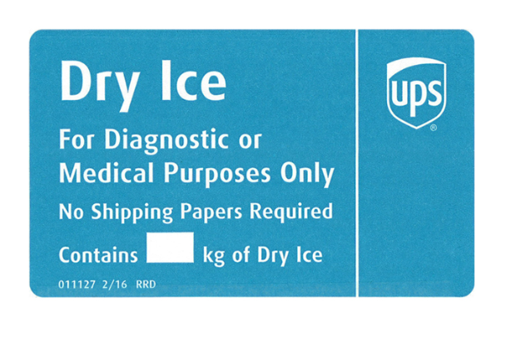
Frozen Shipping: Dry Ice Requirements
Dry Ice label should not be covered with other stickers and must be completed or the shipping carrier will reject/return your package!
Net weight of dry ice in kg
20

Slide 53
Shipping Frozen Samples
Schedule UPS Pickup
  Video for navigating UPS ShipExec™:
  https://www.ncrad.org/shipping_address.html
Send Biological/CSF Sample and Shipment Notification Form to IU ahead of shipment
  Email: alzstudy@iu.edu
    cc: dlkeys@iupui.edu

Slide 54
Shipping Regulations and Training
PLEASE NOTE:
All study personnel responsible for shipping should be certified in biospecimen shipping.
It is the responsibility of each site to ensure that the appropriate training has been provided and conducted in regard to IATA shipping.
Please see following slides for resources.

Slide 55
Federal Regulations/Training
Sites are responsible for ensuring proper training is obtained.
Current federal and international regulations require anyone directly involved with the shipment of potentially infectious materials and other regulated biological materials (including biological specimens and cultures) be properly trained on pertinent shipping requirements.
  International Air Transport Association (IATA) Training
DGI Training Center 800-338-2291 DGItraining.com Provides IATA Certified Air Seminars and online courses | IATA Training Schools North America 1(514)390-6726 Europe, Africa & Middle East 41 (22) 799 2751 Asia, Australia & the Pacific 65 239 7232 www.iata.org Training schools located in 30 countries
Saf-T Pak Inc. www.saftpak.com Provides dangerous goods training via CD or on-site instruction for North America and Europe | Aiconsult Email: Airconsult@wanadoo.fr www.airconsult-bf.com
Bureau of Dangerous Goods LTD., TIANJIN Addr.: No.3 Yingshui road, Nankai district, Tianjin China Tel: 022-23495890 83326960 83326854 / Fax: 022-83326959 Email: cdmin@bdg-china.com.cn www.bdg-china.com.cn

Slide 56
UN3373 Biological Substance, Category B Training
Biological Substance, Category B are specimens being transported for “investigational purposes”
Recommend: investigator sites document training of category B/dangerous goods
We recommend establishing a record of your staff’s training and date of instruction
The training records must be made available upon request by the appropriate national authority
  Additional information from the Department of Transportation (DOT) can be found on their website http://hazmat.dot.gov

Slide 57
Biological Sample and Shipment Notification Forms
A copy of the sample form must be emailed to NCRAD prior to the date of sample arrival.
Please include sample forms in all shipments of frozen samples.
Email: alzstudy@iu.edu
  cc: dlkeys@iupui.edu

Slide 58
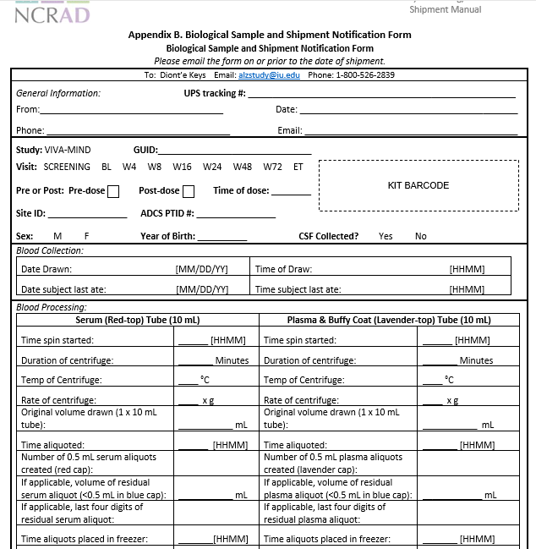
Biological Sample and Shipment Notification Form: Blood
Blood Collection for:
  Serum
  Plasma
  Buffy Coat
Be sure to indicate visit and pre vs. post dose collection status
Send by E-mail prior to shipment and include a copy in each shipment

Slide 59
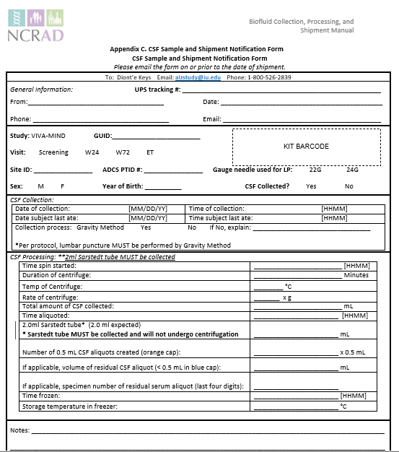
Biological Sample and Shipment Notification Form: CSF
Send by E-mail prior to shipment and include a copy in each shipment
**2ml Sarstedt CSF Tube MUST be collected.

Slide 60
Common Nonconformances
Recommendation:
Place aliquots in cryoboxes/tube rack in freezer upright until shipment
Sample aliquots and collection tubes frozen at an angle/inverted
Fields left blank on Blood/CSF Sample and Shipment Notification Forms
    Last time subject ate often left blank/unknown
Incorrect data reported on Sample and Shipment Notification Forms
Multiple low volume aliquots
Recommendation: Complete Sample Notification forms during the participant study visit as samples are processed.
Recommendation:
Lay out cryovials in a row and aliquot in order until plasma/serum/CSF is depleted

Slide 61
Common Nonconformances
All frozen samples for a participant not sent within one shipment box (Serum, plasma, buffy coat, and CSF aliquots should be kept together)
Aliquots arriving to NCRAD without labels
Sample forms not faxed or scanned to NCRAD the day before shipment
Recommendation:
Ship Samples to NCRAD utilizing the Notification Form, by ADCS ID. Do not throw away labels until samples are packed and shipped.

Slide 62
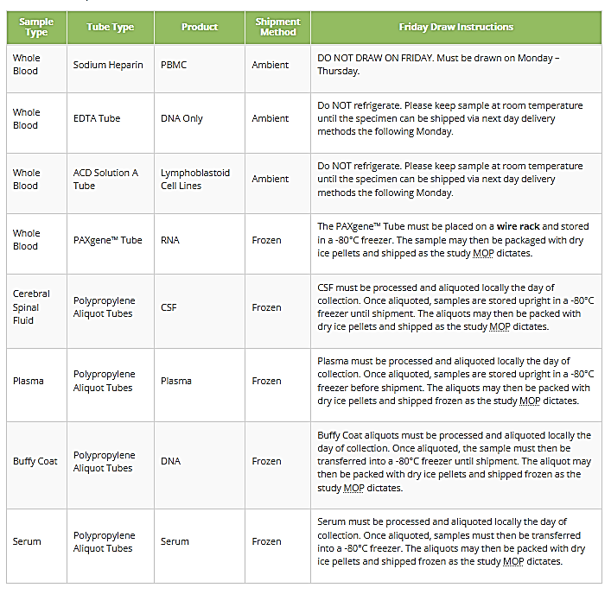
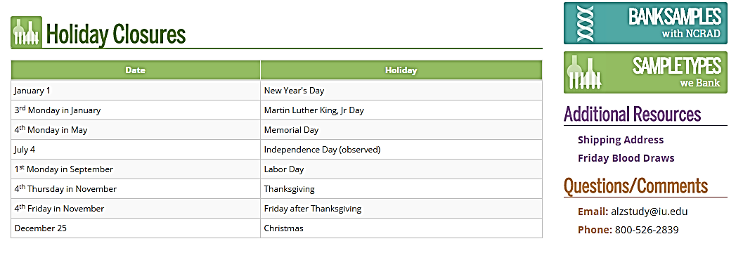
NCRAD Website
Helpful Pages:
  https://ncrad.org/holiday_closures.html
https://www.ncrad.org/friday_blood_draws.html

Slide 63
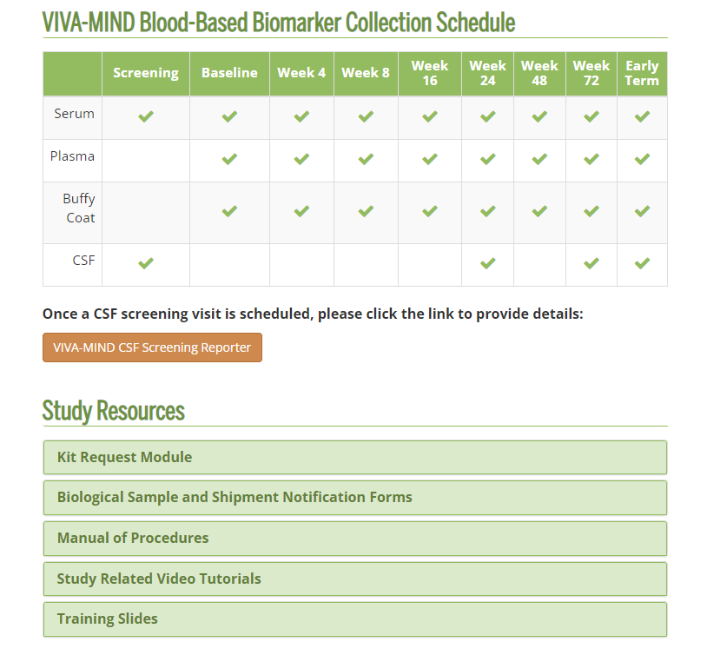
NCRAD Website: VIVA-MIND Active Study Page
https://ncrad.org/resource/viva-mind.html
*Training videos, manual of procedures, and sample forms will be available for reference on the VIVA-MIND
Active Study Page.

Slide 64
Contact Information
Questions?
Please contact NCRAD Coordinator at:
  VIVAMIND Coordinator: Diont’e Keys
  Phone: 317-274-7890
  CRC email: dlkeys@iupui.edu
  Back-up email: alzstudy@iu.edu
  Website: www.ncrad.org

