Slide 1
Alzheimer’s Disease Center Fluid Biomarkers Study
Collection and Shipment Training

Slide 2
Training Overview: ADC FB
GUIDs
Kit Review
Sample Collection and Processing
Sample Shipping
Sample Form
NCRAD Website
Common Nonconformance Issues
Questions?

Slide 3
Globally Unique Identifier (GUID)
The GUID is a subject ID that allows researchers to share data specific to a study participant, without exposing personally identifiable information
A GUID is made up of random alpha-numeric characters and does not include any PHI in the identifier

Slide 4
Generating GUIDs
Create an account: https://bricsguid.nia.nih.gov/portal/jsp/login.jsp
Once you have an account, go to the GUID Tool – Create GUID
To open the ‘Launch GUID Tool’ you will need to have Java installed on your device
When the GUID Tool is open, you will need all of the following information (ADCFB MOP Appendix A):
  Complete legal given (first)name of participant at birth
  The participant’s middle name, if applicable
  Complete legal family (last) name of subject at birth
  Day of birth
  Month of birth
  Year of birth
  Name of city/municipality in which subject was born
  Country of birth

Slide 5
ADCFB Kits
Biospecimen | Total Blood Volume Collected
 | 10 ml | 20 ml | 30 ml | 40 ml | 50 ml
Plasma | X | X | X | X | X
Buffy Coat (DNA) | X | X | X | X | X
PBMC |  |  |  | X | X
Depending on approved blood volume, sites may choose between five blood collection kits.
If desired, sites may also collect and send CSF samples at each annual visit
Biospecimen | Annual visits
CSF | X

Slide 6
Kit Request Module
http://kits.iu.edu/adcfb/
Ncrad.iu.edu > Tools for active studies > Adcfb > kit request module > kit request system

Slide 7
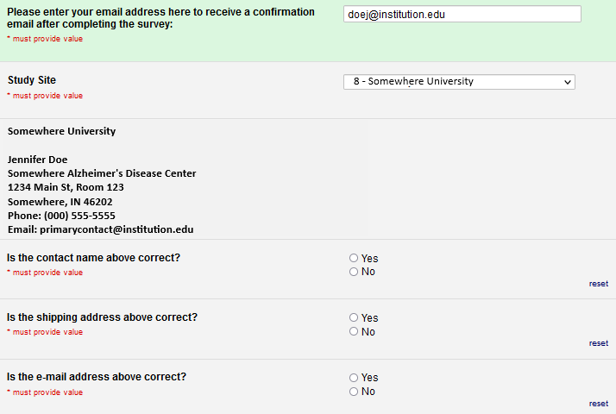
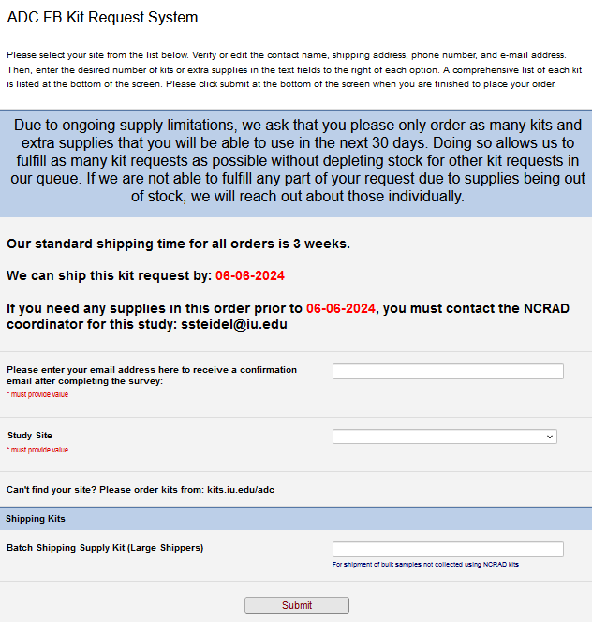
ADCFB Kit Request Module
Enter email
Choose your site from the drop-down list.
The coordinator name and contact information will appear.
Verify that this information is accurate and correct if necessary.

Slide 8
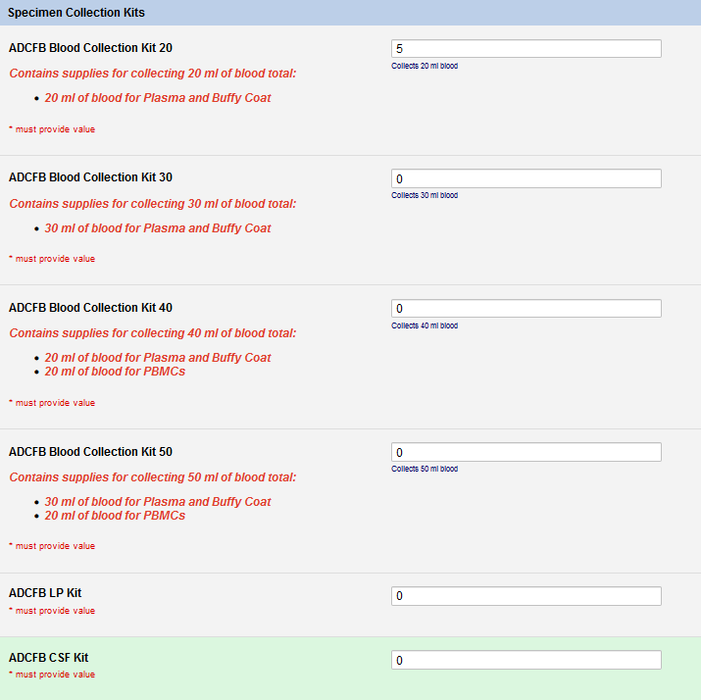
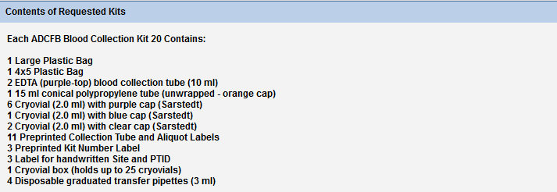
Kit Request Module, Continued 1
Indicate the quantity needed of each Specimen Collection Kit
Once selected, kit components of the chosen kit will appear at the bottom of the screen
**Note: You can order more than one type of kit in a single kit request**

Slide 9
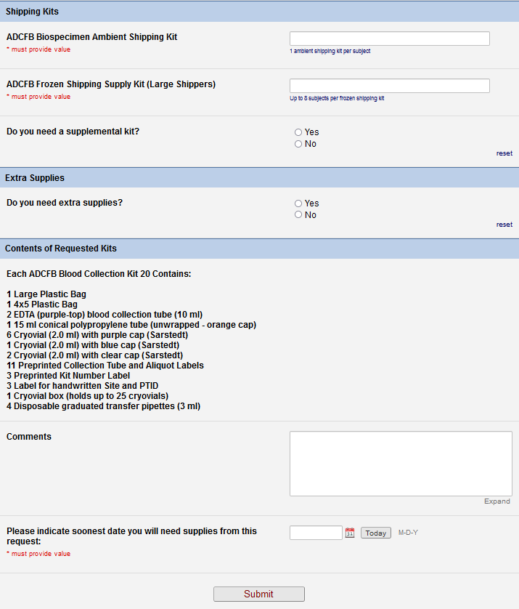
Kit Request Module, Continued 2
Indicate the quantity needed of each Shipping Kit
Indicate if a Supplemental Kit is needed
Indicate if Extra Supplies are needed. If yes, enter quantities.
Use Comments to request unlisted or special supplies
Click “Submit” to turn in your request.

Slide 10
Specimen Labels

Slide 11
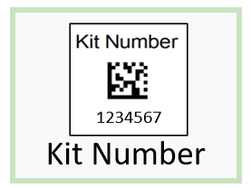
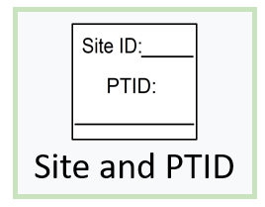
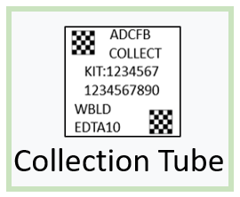
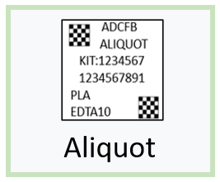
Three Label Types

Slide 12
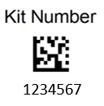
Kit Number Labels
Used to track patient samples and provide quality assurance – Will be placed on the following locations :
  Blood Sample and Shipment Notification Forms
  Cryoboxes that house aliquots during shipping
  One extra label provided
Provided by NCRAD in the kits

Slide 13
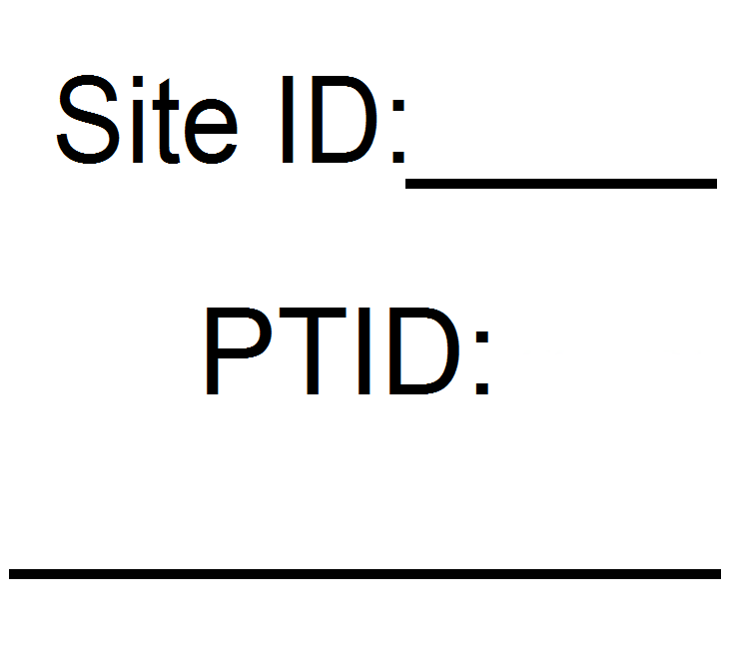
Site and PTID Labels
Subjects will be identified by their Site and PTID
Sites will be responsible for handwriting this onto the provided labels
  Must use fine point permanent marker

Slide 14
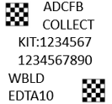
Collection Tube Labels
Collection Tube Labels:
  Study name
  Label Type “COLLECT” (Collection)
  7 digit Kit Number
  10 digit Specimen Barcode (Specimen Number)
  Specimen Type code
  Collection Tube Type
  Two 2D barcodes

Slide 15
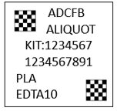
Aliquot Labels
Aliquot Labels:
  Study name
  Label Type “ALIQUOT”
  7 digit Kit Number
  10 digit Specimen Barcode (Specimen Number)
  Specimen Type code
  Collection Tube Type
  Two 2D barcodes

Slide 16
Blood Collection Tubes
Label 1: Site and PTID label
Label 2: Collection Tube label
All collection tubes will have two labels:
  The handwritten Site and PTID label
  The collection tube label

Slide 17
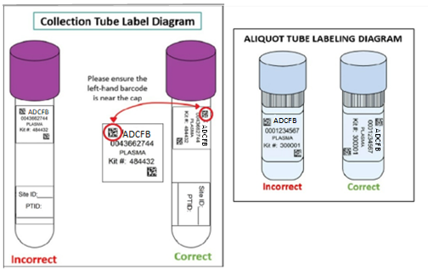
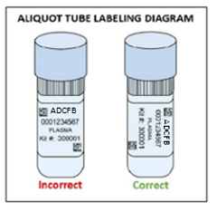
Labeling Biologic Samples
Label all collection and aliquot tubes before cooling, collecting, processing or freezing samples
Label only 1 subject’s tubes at a time to avoid mix-ups
Wrap the label around the tube horizontally. Label position is important for all tube types
Make sure the label is completely adhered by rolling between your fingers

Slide 18
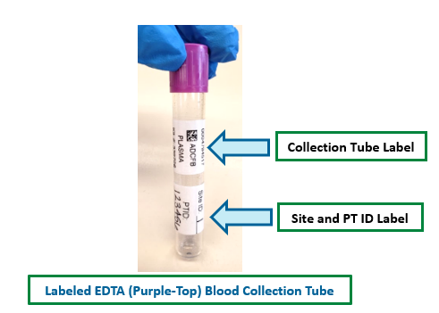
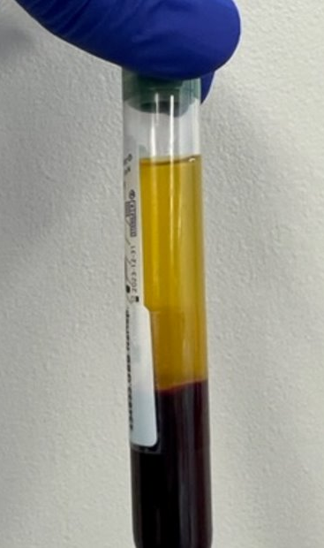
Collection Tube Labeling
Attach labels to allow a viewing window down the length of the tube to ensure Buffy Coat is visible during processing.
Manufacturer label
NCRAD Label
Buffy Coat

Slide 19
Handling/Processing
Study Specimens

Slide 20


Blood Draw Order
Tube Type* | Number of Tubes Drawn | Tube Image
1. NaHep (Green-Top) Tube (10 ml) | 2 (20 ml)
2. EDTA (Purple-Top) Tube (10 ml) | 2 (20 ml) or 3 (30 ml)
*If drawing blood for PBMCs, Sodium Heparin tubes must be the first tubes into which blood is collected. If not, the EDTA tubes will be first.

Slide 21
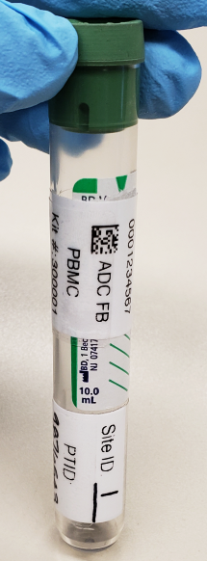
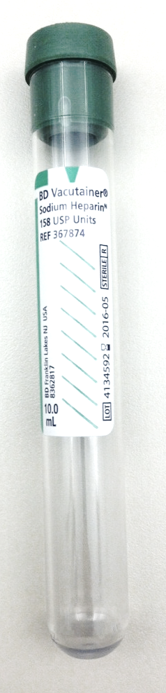
PBMC Collection
2 x Sodium heparin (green top) BD Vacutainer® (10 ml)
  Not processed at site
  *NOTE*: Must be shipped AMBIENT to NCRAD the day sample is drawn. No Friday Draws.

Slide 22
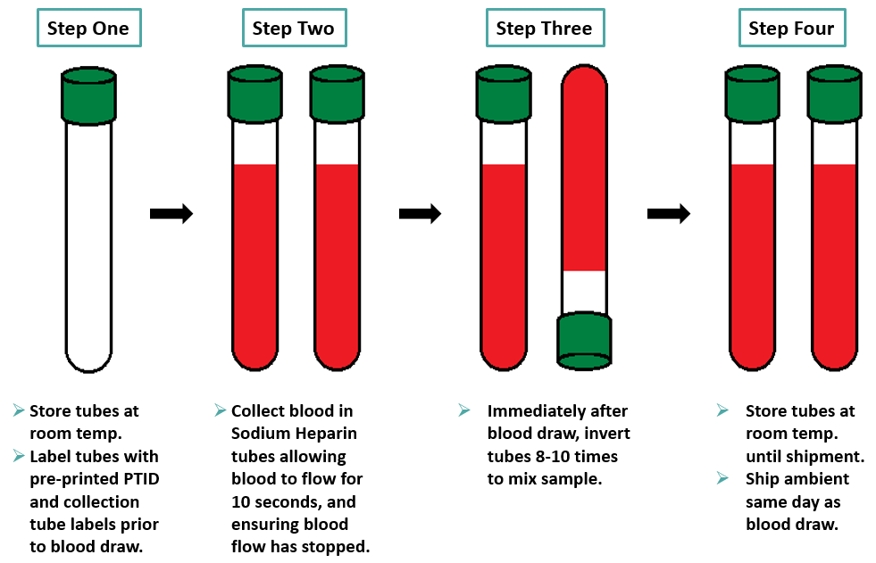
PBMC Preparation (10ml Sodium Heparin Tube x 2)

Slide 23
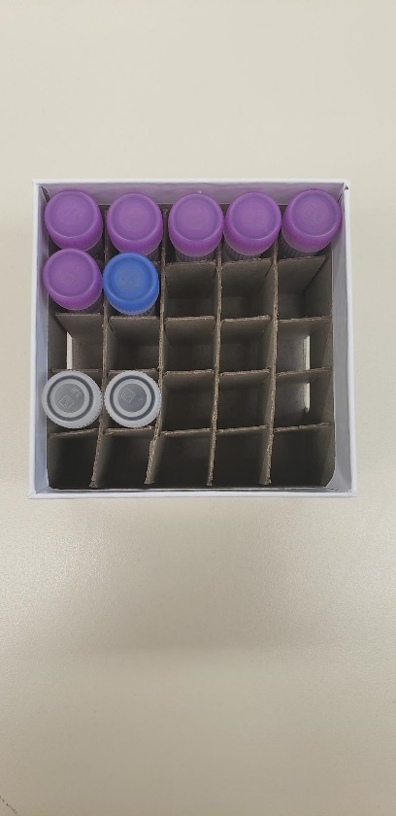

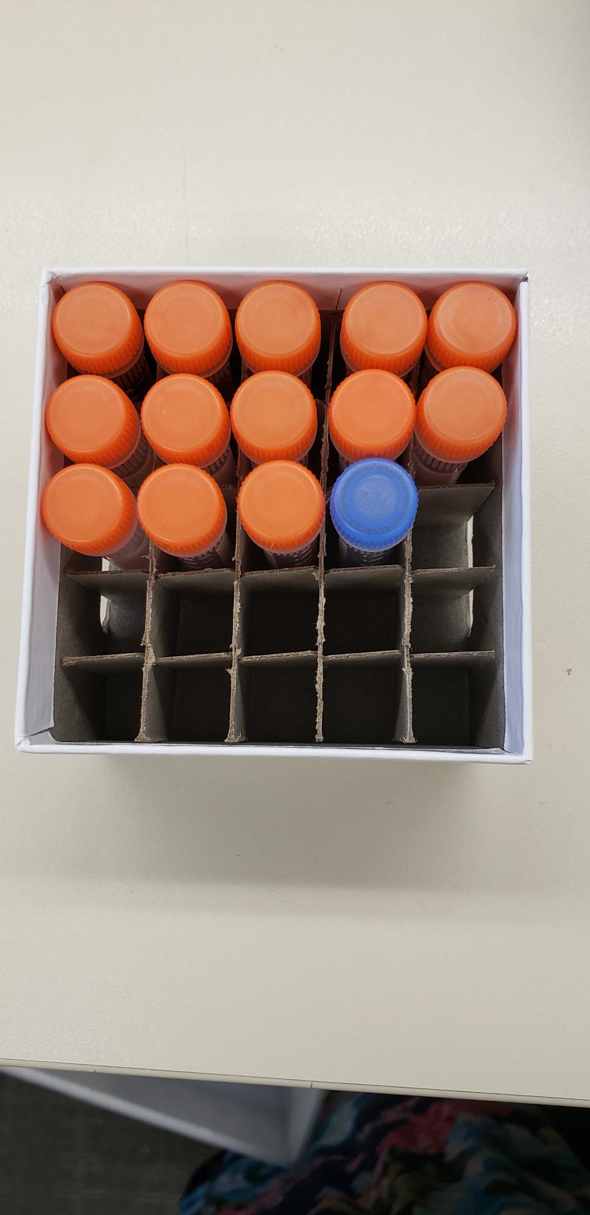
Cryovial Cap Colors
Cap Color | Sample Type | Cap Image
Purple | Plasma
Blue | Residual (Plasma or CSF)
Clear | Buffy Coat
Orange | CSF

Slide 24
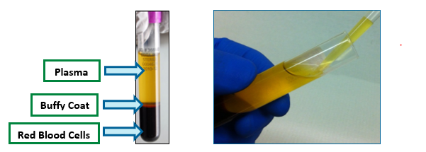
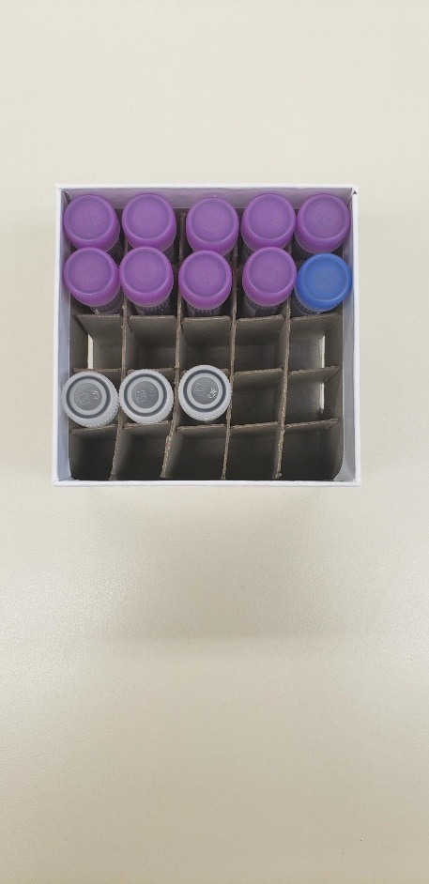
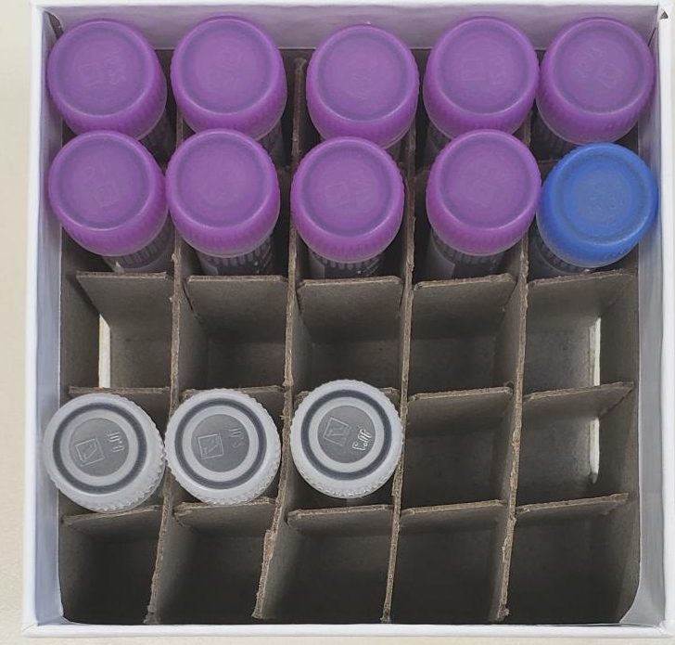
Plasma Collection
Create up to:
  4 aliquots (10 ml kit) or
  7 aliquots (20 ml or 40 ml kit) or
  10 aliquots (30 ml or 50 ml kit)
10 ml kit:
  Three 1.5ml aliquots in purple caps
  One residual aliquot in blue cap
20 ml or 40 ml kit:
  Six 1.5ml aliquots in purple caps
  One residual aliquot in blue cap
30 ml or 50 ml kit:
  Nine 1.5ml aliquots in purple caps
  One residual aliquot in blue cap
10 ml Kit
20 ml or 40 ml Kit
30 ml or 50 ml Kit

Slide 25
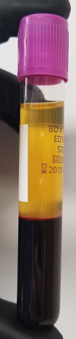
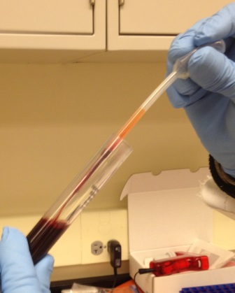

Buffy Coat Collection
Buffy Coat
Expected to have a reddish color from the RBCs.
Be sure to only place the buffy coat from one EDTA tube into each cryovial
Create up to:
  2 buffy coats (20 ml or 40 ml kit)
  3 buffy coats (30 ml or 50 ml kit)

Slide 26
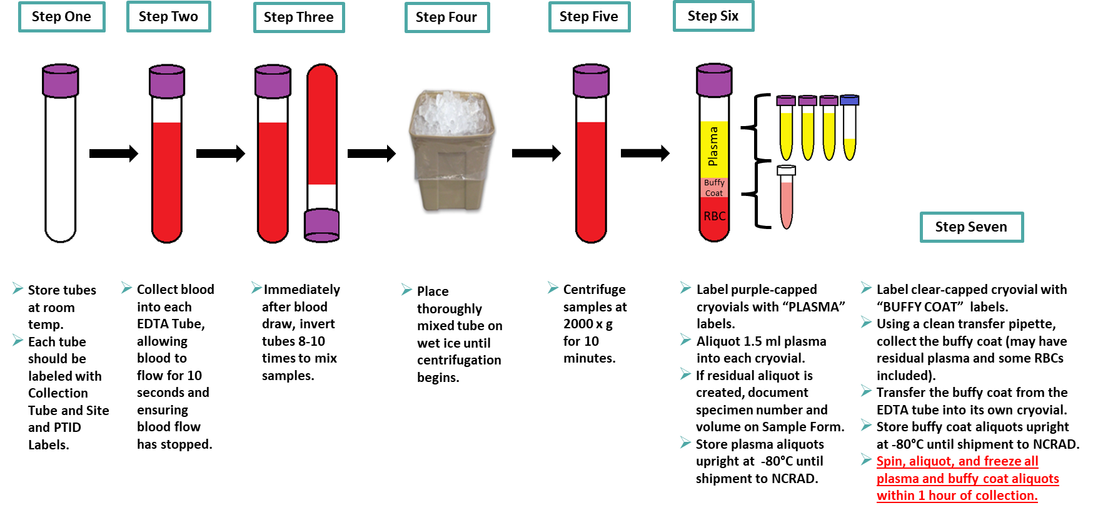
Plasma/Buffy Coat Collection and Processing: 10 ml
at 4C.
Spin, aliquot, and freeze all plasma and buffy coat aliquots within 2 hours of collection.

Slide 27
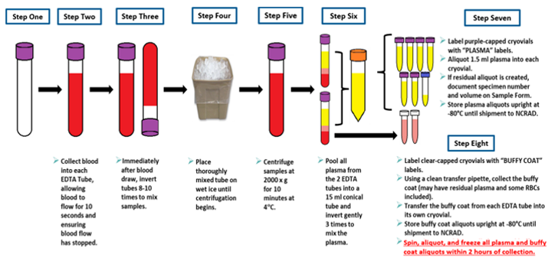
Plasma/Buffy Coat Collection and Processing: 20 ml

Slide 28
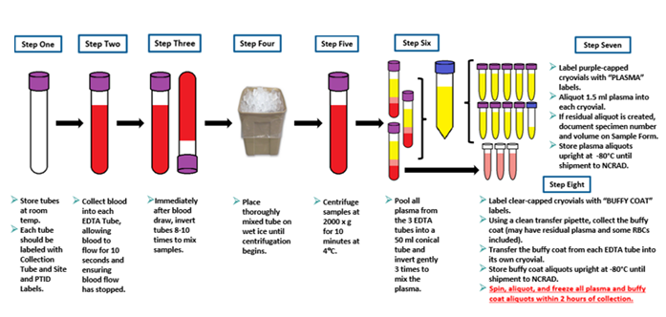
Plasma/Buffy Coat Collection and Processing: 30 ml

Slide 29
CSF Collection
Create up to:
  14 aliquots
    13 1.5ml aliquots in orange caps
    1 residual aliquot in blue cap

Slide 30
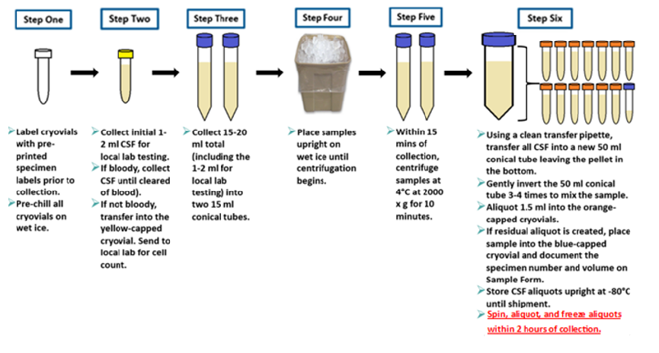
CSF Preparation (15-20 ml total)

Slide 31
Packaging Sample Shipments

Slide 32
Sample Shipment Summary
Collection Tube | Drawn At | Specimen Type | Aliquot Volume | Total Number of Aliquots | Shipping Temperature
2 Sodium Heparin (Green-Top) Blood Collection Tubes (10 ml) | Each visit | Whole Blood | N/A | N/A | Ambient
1, 2, or 3 EDTA (Purple-Top) Blood Collection Tubes (10 ml) | Each visit | Plasma | 1.5 ml plasma aliquots | Up to 10 | Frozen
 | Each visit | Buffy Coat | ~1.0 ml buffy coat aliquots | Up to 3 | Frozen
Sterile Container | Each visit | CSF | 1.5 ml CSF aliquots | Up to 14 | Frozen

Slide 33
Ambient Shipment Packaging
Only Monday-Thursday collection and same day shipping. Plan ahead to schedule UPS.
Samples must be received at NCRAD one day after collection.
Include copy of Blood Sample Shipment and Notification Form
Do NOT draw or ship ambient samples on Friday

Slide 34
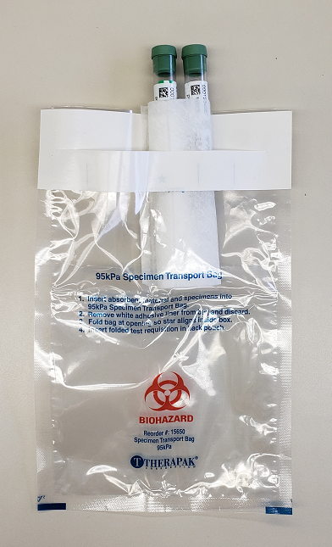
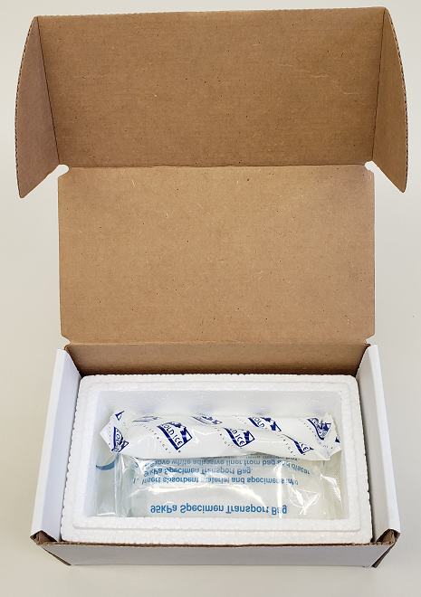
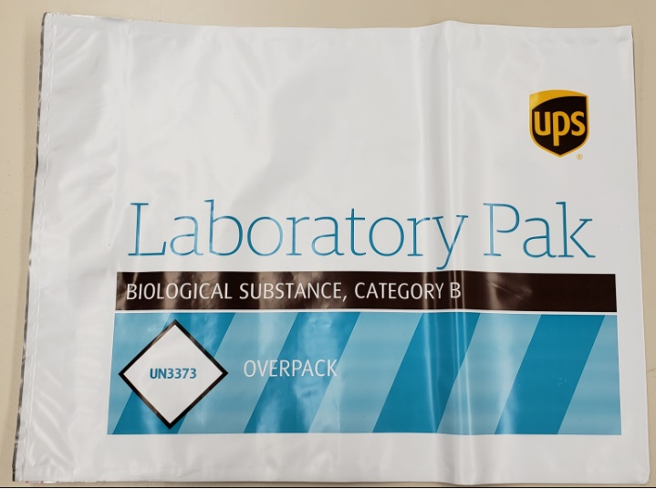
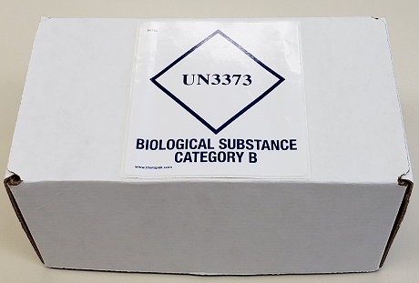
Preparing Ambient Shipments
Place the ambient PBMC tubes in the absorbent slots and biohazard bag.
Place the bag inside the small shipping box, and then set the refrigerant pack on top of it.
Place small shipping box within a provided UPS Laboratory Pak, seal, and place UPS label on outside of package.
*Gel packs must be put in a freezer at minimum the night before shipping.

Slide 35
Preparing Frozen Shipments
All samples shipped frozen to NCRAD Monday-Wednesday ONLY
Hold packaged samples in a -80°C freezer until pickup
Include copy of Blood Sample Shipment and Notification Form
Batch samples together (3 or 8 cryoboxes)

Slide 36
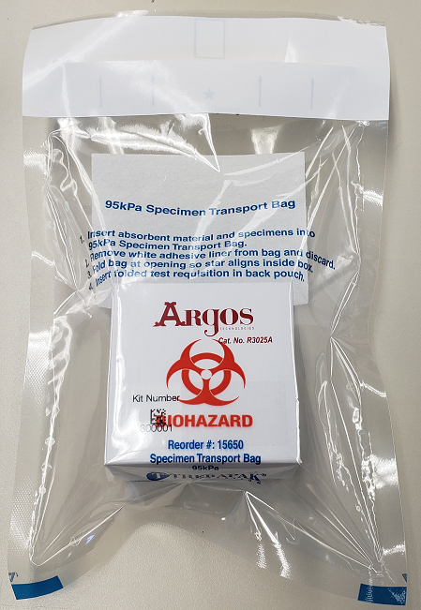
Packaging Samples
Use the biohazard bag to package the 25-Slot cryobox

Slide 37
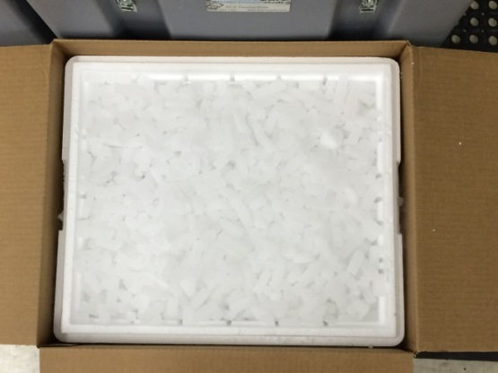
Frozen Shipment Packaging
Place 2-3 inches of dry ice in the bottom of the Styrofoam shipping container, then insert the cryoboxes laying upright.
Fully cover the cryoboxes with about 2 inches of dry ice in the provided shipper.
Each Styrofoam shipper must contain about 45 lbs (20 kg) of dry ice.
Fill shipper to the top with dry ice!

Slide 38
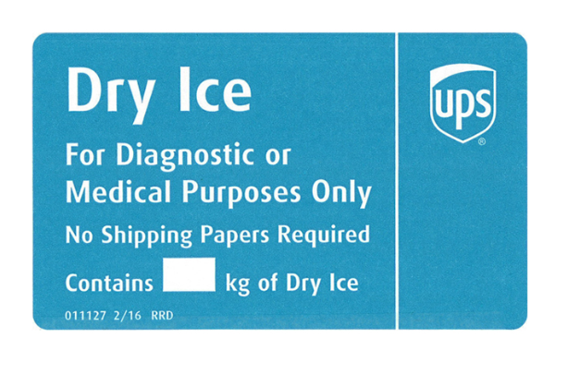
Frozen Shipping – Dry Ice Requirements
Dry Ice label should not be covered with other stickers and must be completed or the shipping carrier will reject/return your package!
Net weight of dry ice in kg
20

Slide 39
Creating Airbills/Scheduling Pickups

Slide 40

UPS ShipExecTM Thin Client Website
Log into the ShipExec Thin Client: https://kits.iu.edu/UPS
Click on the “Shipping” dropdown and click on “Shipping and Rating”

Slide 41
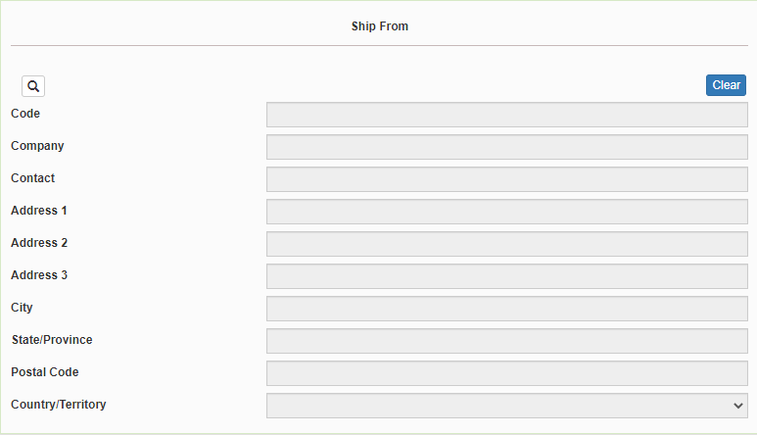
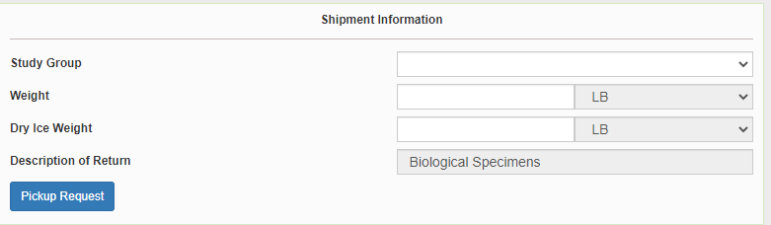
Finding Your Contact Information
On the right side of the screen, find and choose the name of your study from the “Study Group” drop down menu
  This step must be done 1st
On the left side of the screen, Click on the magnifying glass icon

Slide 42
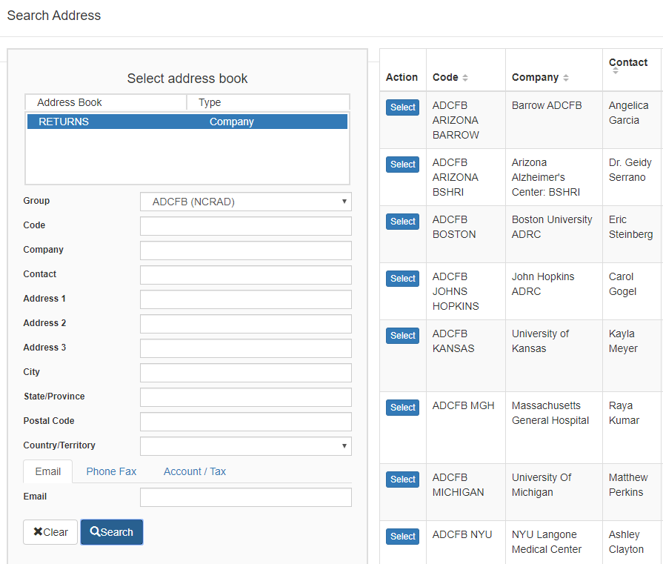
Finding Your Contact Information, Continued
On the right side of the screen, a list of all the site addresses within the study you selected should populate
User can filter the search for their address further by filling in the “Company”, “Contact”, or “Address 1” fields
Hit “Search” when ready.
Once you have found your site address, click on the “Select” button to the left of the address
If any information needs to be updated, please reach out to the NCRAD Coordinator of your study

Slide 43
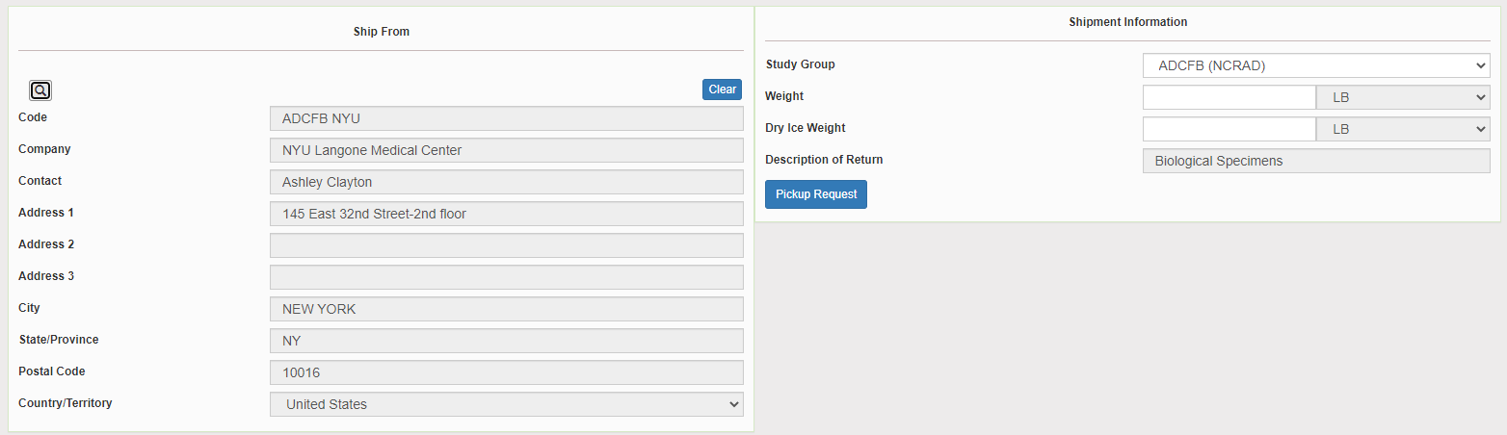
Verify Information
Please verify that both the shipping information AND study reference are correct for this shipment

Slide 44
Entering Shipment Information
Ambient shipments
  Enter the total weight of your package in the “Weight” field, leave the “Dry Ice Weight” field empty!
  Frozen shipments
    Enter the total weight of your package in the “Weight” field
    Enter the dry ice weight in the “Dry Ice Weight” field
      The “Dry Ice Weight” field cannot be higher than the “Weight” field (will receive an error message)

Slide 45
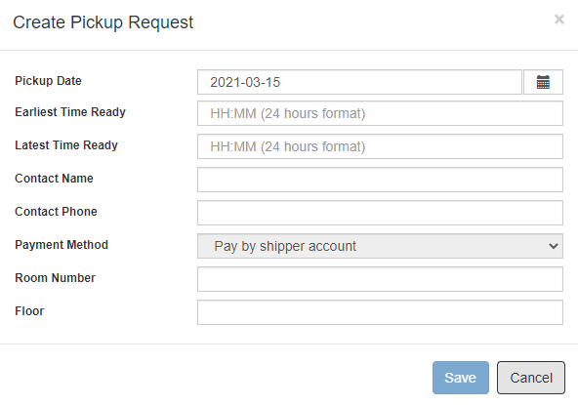
Need to request UPS Pickup?
Click on the “Pickup Request” button
Fill out all fields for the pickup request
Enter in the “Earliest Time Ready” and “Latest Time Ready” in 24-hour format
  Users must schedule pickup minimum 1 hour before “Earliest Time Ready”
Choose a name and number that is the best to contact if the UPS driver has questions related to picking up your package
Entering the Room Number and Floor will help the UPS driver locate your package
  Room number field is free text
  Floor field is numerical only
Hit “Save” when done

Slide 46
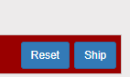
Shipping Packages
If all fields in “Ship From” and “Shipment Information” fields are completed, and pickup request is completed (if necessary), click Ship in the bottom right corner of the page

Slide 47
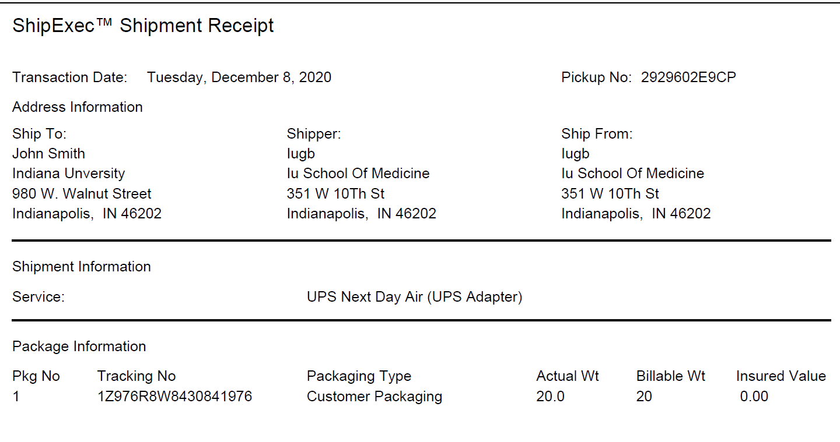
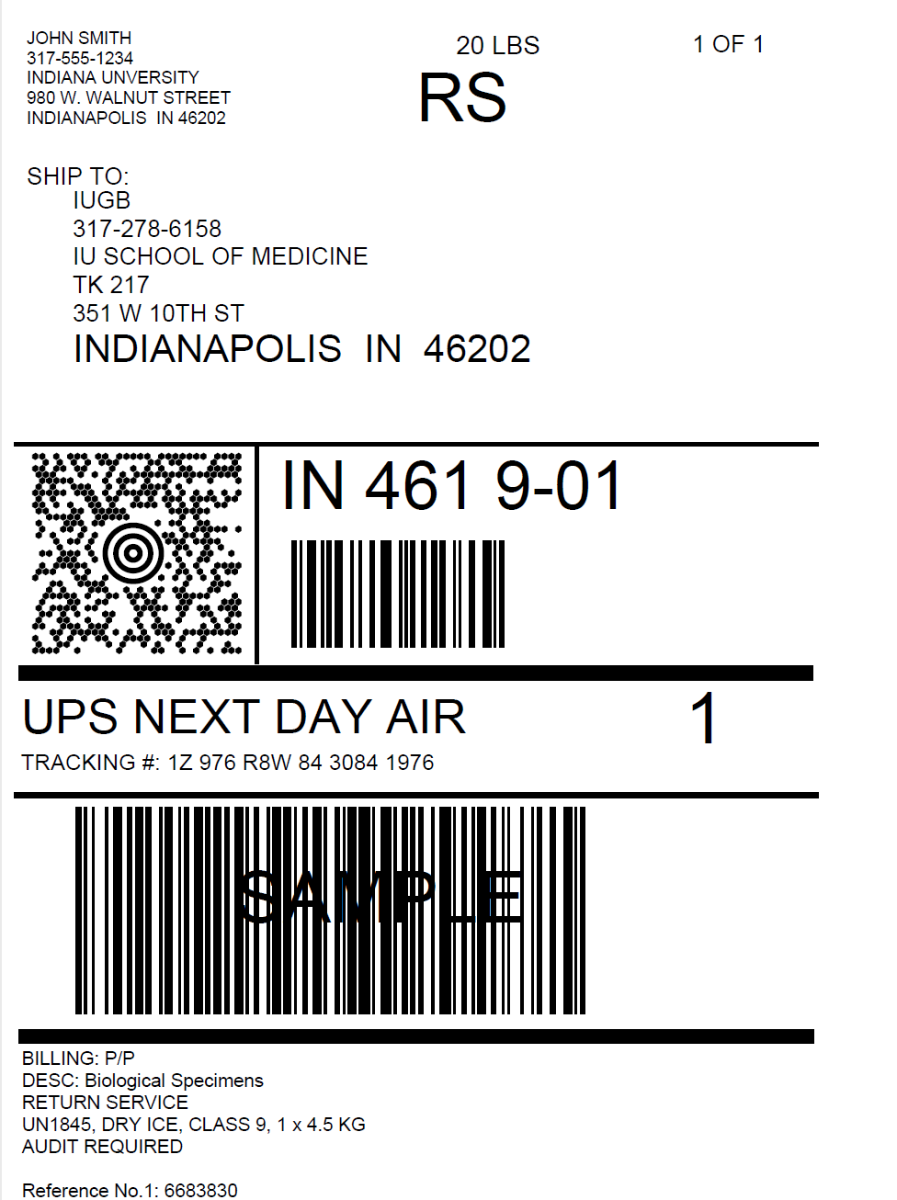
Accessing Airbill
Shipment Receipt
Airbill
Check Pickup Status by going to UPS.com, click on Shipping, select Schedule a Pickup, and “Pickup Status”. Enter in the Pickup No. listed on receipt into PRN field and submit.

Slide 48
Accessing Airbill, Continued
Print out the UPS air waybill.
Fold the UPS air waybill and slide it inside the plastic UPS sleeve (NCRAD will provide these in shipping kits).
Peel the back off the plastic UPS sleeve and stick the sleeve to your package, making sure it is laying as flat as possible along the surface of the package.

Slide 49

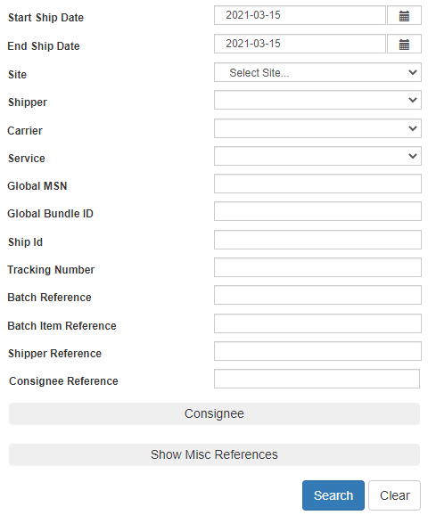
Reprint Airbills/Voiding Shipments
To reprint airbill or void a shipment, click “History” at the top of the ShipExec Thin Client portal
If your shipment doesn’t automatically pop up, enter in the date of shipment and then click “Search”

Slide 50
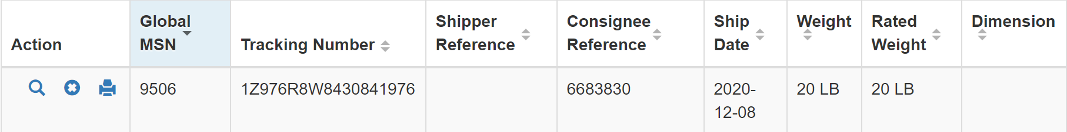
Reprint Airbill
Click the print icon to reprint airbill

Slide 51
Void Shipment
To void a shipment, click on the “X” symbol

Slide 52
Blood Sample and Shipment Notification Form

Slide 53
Blood Sample and Shipment Notification Form
A copy of the sample form must be emailed or faxed to NCRAD prior to the date of sample arrival.
Please include sample forms in all shipments of frozen and ambient samples.
Email: alzstudy@iu.edu

Slide 54
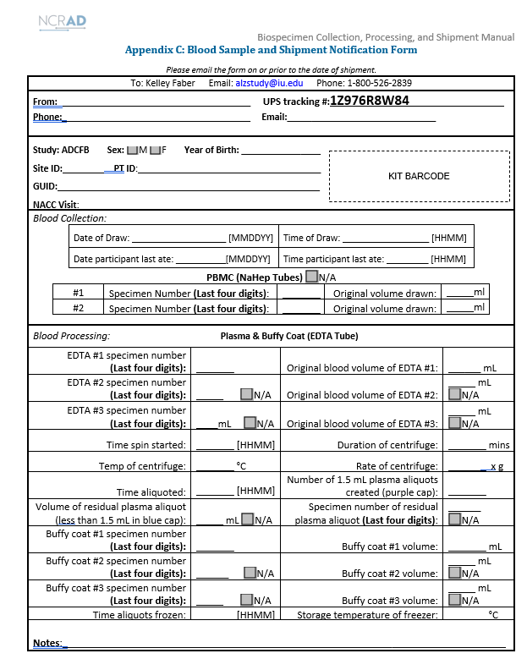
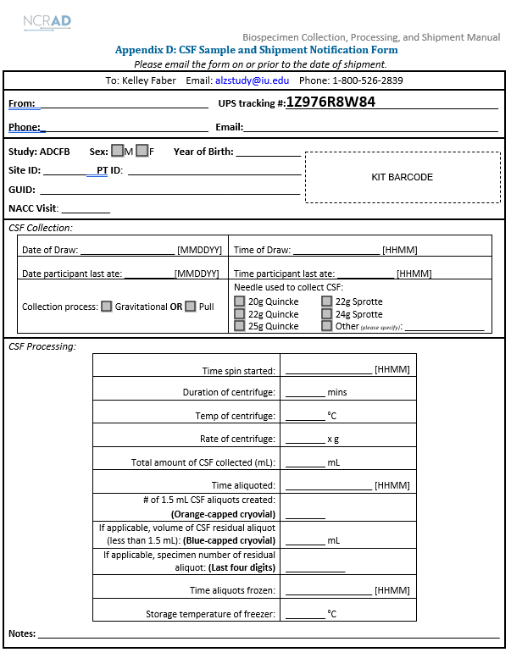
Example Sample and Shipment Notification Forms

Slide 55
Noncomformance Issues

Slide 56
Nonconformance Issues 1
Sample aliquots and collection tubes frozen at an angle/inverted
Recommendation:
Place aliquots in Argos boxes/tube rack in freezer upright until shipment
Fields left blank on Blood Sample and Shipment Notification Form
Last time subject ate often left blank/unknown
Incorrect data reported on Sample and Shipment Notification Forms
Recommendation: Complete Sample Notification forms during the participant study visit as samples are processed.

Slide 57
Nonconformance Issues 2
Recommendation:
No samples should be held ambient for any period of time at the site. Ensure all ambient PBMC samples are shipped by end of the day.
Ambient PBMC samples not shipped to NCRAD the day of blood draw
All frozen samples for a participant not sent within one shipment box (plasma and buffy coat aliquots should be kept together)
Aliquots arriving to NCRAD without labels
Sample forms not faxed or scanned to NCRAD the day before shipment
Recommendation:
Ship Samples to NCRAD utilizing the Notification Form by PTID. Do not throw away labels until samples are packed and shipped.

Slide 58
Nonconformance Issues 3
Multiple low volume aliquots
Recommendation:
Lay out cryovials in a row and aliquot in order until sample is depleted

Slide 59
NCRAD Website

Slide 60

NCRAD Website: Helpful Pages
https://ncrad.org/contact/holiday-closures
https://ncrad.org/contact/shipping-resources
Date | Holiday
January 1st | New Year’s Day
3rd Monday in January | Martin Luther King, Jr Day
4th Monday in May | Memorial Day
June 19 | Juneteenth
July 4 | Independence Day
1st Monday in September | Labor Day
4th Thursday in November | Thanksgiving
4th Friday in November | Friday after Thanksgiving
December 25th | Christmas Day
December 26th – 31st | Winter Break

Slide 61
Contact Information
Stephanie Steidel
Phone: (317) 274-1685
E-mail: ssteidel@iu.edu
General NCRAD Contact
Phone: (800) 526-2839
E-mail: alzstudy@iu.edu
Website: www.ncrad.org

