Slide 1
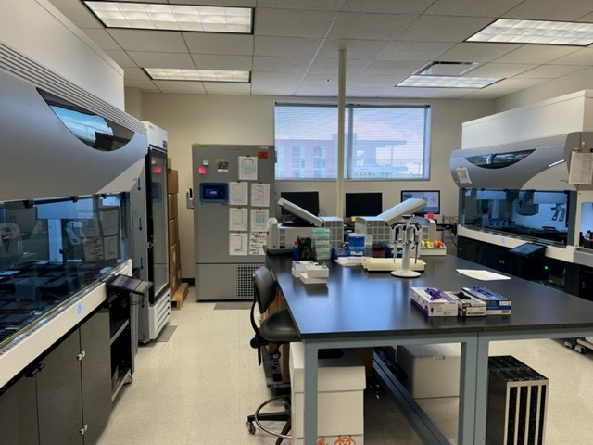
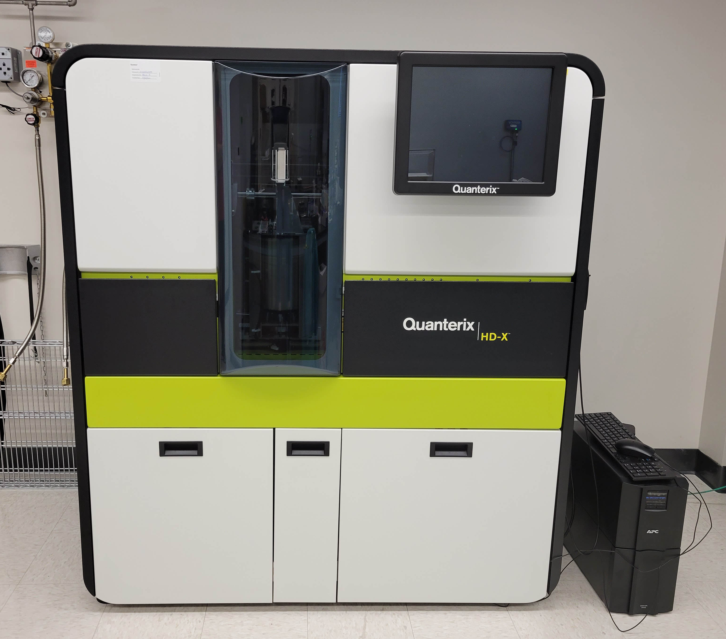

Overview of Blood-based Biomarkers Available for Assay through the NCRAD Biomarker Assay Laboratory

Slide 2
Beta Amyloid Peptides
NCRAD BAL Aβ1-40 and Aβ1-42 Assay Options:
Plasma:
Quanterix Simoa HD-X Neurology 4-Plex E Advantage kits following the manufacturer’s instructions. Plasma samples will be analyzed in duplicate following a 1:4 dilution in sample buffer. The Neurology 4-Plex E kit measures GFAP, NfL, Abeta 40, and Abeta 42.
Fujirebio Lumipulse G β-Amyloid 1-40 and Lumipulse G 1-42 Assays following the manufacturer’s instructions. Analysis in duplicate is not required.
CSF:
Fujirebio Lumipulse G β-Amylid 1-40 and Lumipulse G 1-42 Assays following the manufacturer’s instructions. Analysis in duplicate is not required. (Coming Soon)
Beta-amyloid peptides (Aβ) are normally occurring proteolytic fragments of amyloid precursor protein (APP)¹. There are multiple forms of Aβ peptides, but Aβ1-42 is one of the main components of amyloid plaques, which occur in the brain of patients with Alzheimer’s disease (AD).The ratio of Aβ1-40 and Aβ1-42 has been shown to increase consistency of results with other measures².

Slide 3
Phosphorylated Tau 181 (P-tau)
The microtubule associated protein tau (tau) is another structural protein expressed in Neurons. The phosphorylation of tau is thought to be associated with its function facilitating transport along microtubules. However, in many pathological conditions, tau becomes hyperphosphorylated, aggregated and mis-localized³. Fragments of tau have been identified in cerebral spinal fluid and blood and these have been shown be phosphorylated at several sites (P-tau). P-tau can be measured in blood of unaffected subjects and likely represents the normal process of axonal remodeling. In the early stages of Alzheimer’s disease, P-tau levels in blood become elevated near the time amyloid becomes abnormal by PET imaging⁴
NCRAD P-tau181 Assay Options:
Plasma:
Plasma levels of P-tau will be measured using a Quanterix Simoa HD-X pTau-181 V2.1 Advantage kit following the manufacturer’s instructions. Plasma samples will be analyzed in duplicate following a 1:4 dilution in sample buffer.
Fujirebio Lumipulse G Ptau181 Assay following the manufacturer’s instructions. Analysis in duplicate is not required. (Coming soon)

Slide 4
Neurofilament Light Chain
Neurofilament Light Chain (NfL) is a normally occurring cytoskeletal protein expressed in neurons³. Low levels can be measured in blood samples because of normal axonal remodeling, but levels have shown to be elevated above age matched non-affected subjects in many neurodegenerative conditions including but not limited to multiple sclerosis, amyotrophic lateral sclerosis, frontotemporal lobar degeneration, stroke and AD^{5,6,7}. Plasma levels of NfL will be measured using a Quanterix Simoa-HD-X NF-Light Advantage assay kit following the manufacturer’s instructions. Plasma samples will be analyzed in duplicate following a 1:4 dilution in sample buffer. NfL is also available on the the Neurology 2-Plex B kit which measures both GFAP and NfL, and the Neurology 4-Plex E kit that measures GFAP, NfL, Abeta 40, and Abeta 42.

Slide 5
Glial Fibrillary Acidic Protein
Glial fibrillary acidic protein (GFAP) is a cytoskeletal protein expressed predominately in astrocytes in the CNS². Levels can be measured in blood as a normal function of astrocyte expressing cell type function or turnover. Elevated levels are hypothesized to be a result of astrocytosis, or glial scar formation as a result of neuronal damage but more data is needed to elucidate the precise etiology of elevated plasma GFAP⁸. Plasma levels of GFAP will be measured using a Quanterix Simoa HD-X Neurology 2-Plex B or Neurology 4-Plex E kit following the manufacturer’s instructions. Plasma samples will be analyzed in duplicate following a 1:4 dilution in sample buffer. The Neurology 2-Plex B kit measures both GFAP and NfL. The Neurology 4-Plex E kit measures GFAP, NfL, Abeta 40, and Abeta 42.

Slide 6
Blood-based Biomarkers for AD Pathology
Blood-based Biomarkers
Alzheimer’s Disease Pathology
Amyloid beta peptide Ratio
(Aβ42/40)
Phosphorylated Tau
(P-tau)
Neurofilament Light Chain
(NfL)
© Weinzerl/School of Medicine
The Trustees of Indiana University

Slide 7
Application of Blood-based AD Biomarkers to NIA Research Framework
Blood-Based Biomarkers
NIA-AA AT(N) Framework
Amyloid beta peptide ratio
(Aβ42/40)
β Amyloid Deposition (A)
Pathologic Tau (T)
Phosphorylated Tau
(P-tau)
Neurofilament Light Chain
(NfL)
Neurodegeneration (N)
Jack CR Jr et al., NIA-AA Research Framework: Toward a biological definition of Alzheimer's disease. Alzheimer’s Dement. 2018 Apr;14(4):535-562.

Slide 8
References
1. Chen GF, Xu TH, Yan Y, et al. Amyloid beta: structure, biology and structure-based therapeutic development. Acta Pharmacol Sin. 2017;38(9):1205-1235. doi:10.1038/aps.2017.28
2. Leuzy A, Mattsson-Carlgren N, Palmqvist S, Janelidze S, Dage JL, Hansson O. Blood-based biomarkers for Alzheimer's disease. EMBO Mol Med. 2022;14(1):e14408. doi:10.15252/emmm.202114408
3. Lewczuk P, Łukaszewicz-Zając M, Mroczko P, Kornhuber J. Clinical significance of fluid biomarkers in Alzheimer's Disease. Pharmacol Rep. 2020;72(3):528-542. doi:10.1007/s43440-020-00107-0
4. Janelidze S, Mattsson N, Palmqvist S, et al. Plasma P-tau181 in Alzheimer's disease: relationship to other biomarkers, differential diagnosis, neuropathology and longitudinal progression to Alzheimer's dementia. Nat Med. 2020;26(3):379-386. doi:10.1038/s41591-020-0755-1
5. Verde F, Otto M, Silani V. Neurofilament Light Chain as Biomarker for Amyotrophic Lateral Sclerosis and Frontotemporal Dementia. Front Neurosci. 2021;15:679199. Published 2021 Jun 21. doi:10.3389/fnins.2021.679199
6. Varhaug KN, Torkildsen Ø, Myhr KM, Vedeler CA. Neurofilament Light Chain as a Biomarker in Multiple Sclerosis. Front Neurol. 2019;10:338. Published 2019 Apr 5. doi:10.3389/fneur.2019.00338
7. Khalil M, Teunissen CE, Otto M, et al. Neurofilaments as biomarkers in neurological disorders. Nat Rev Neurol. 2018;14(10):577-589. doi:10.1038/s41582-018-0058-z
8. Hol EM, Pekny M. Glial fibrillary acidic protein (GFAP) and the astrocyte intermediate filament system in diseases of the central nervous system. Curr Opin Cell Biol. 2015;32:121-130. doi:10.1016/j.ceb.2015.02.004

